Slide 2
What is graphic about?

Slide 3
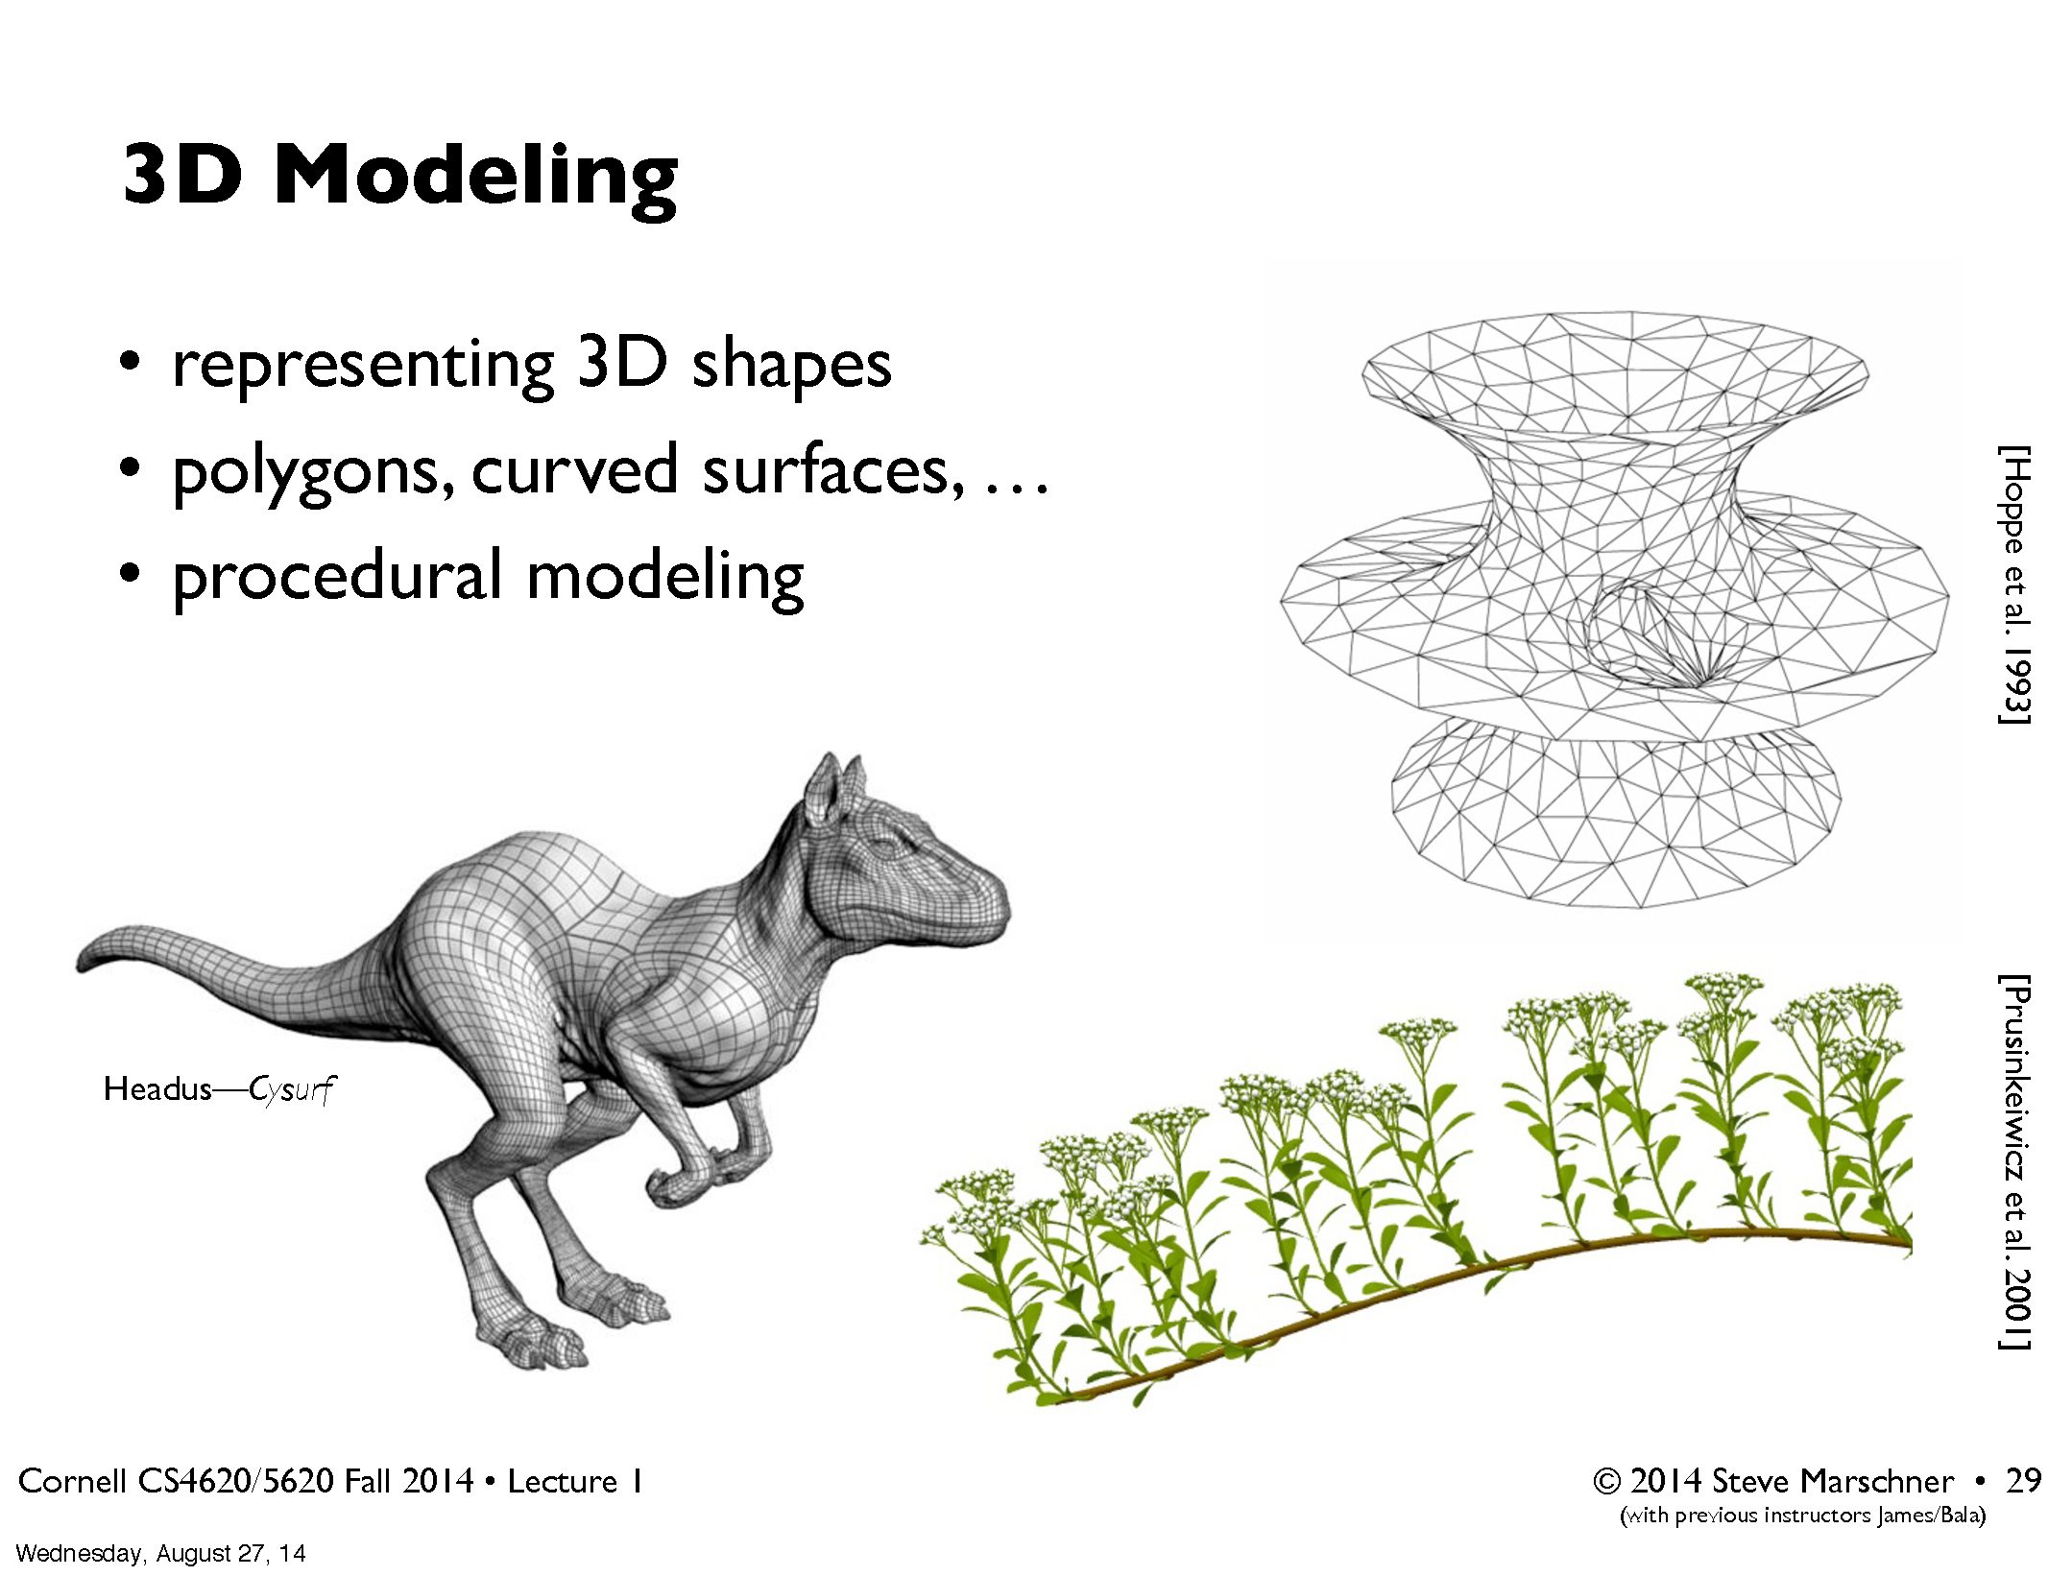

Slide 4
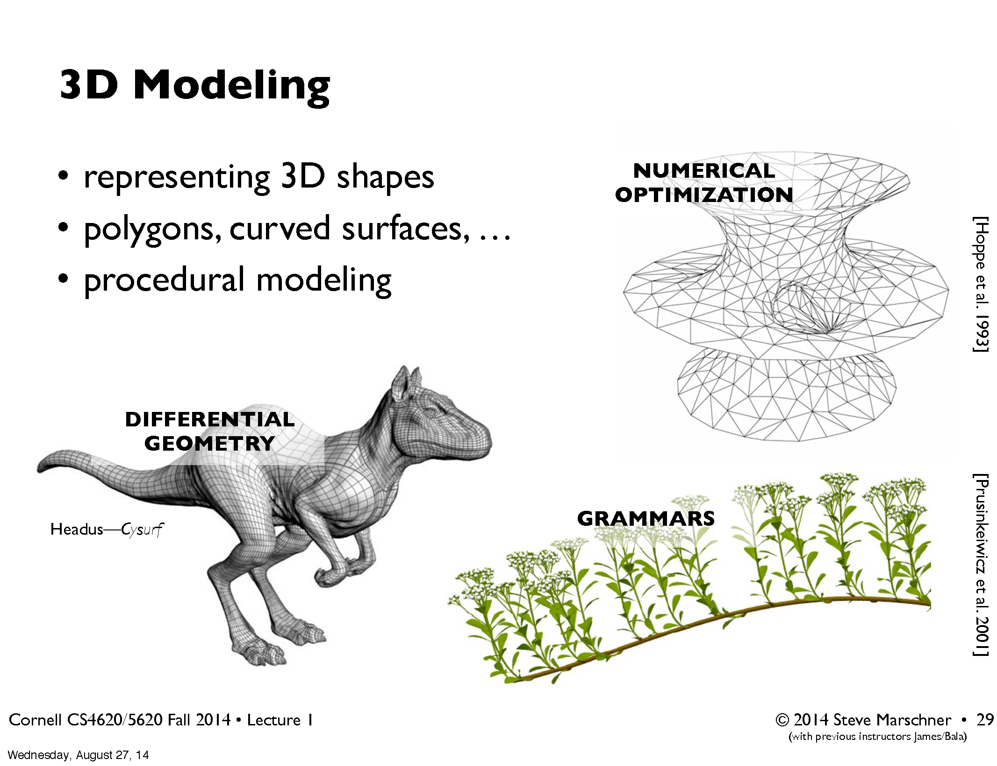

Slide 5
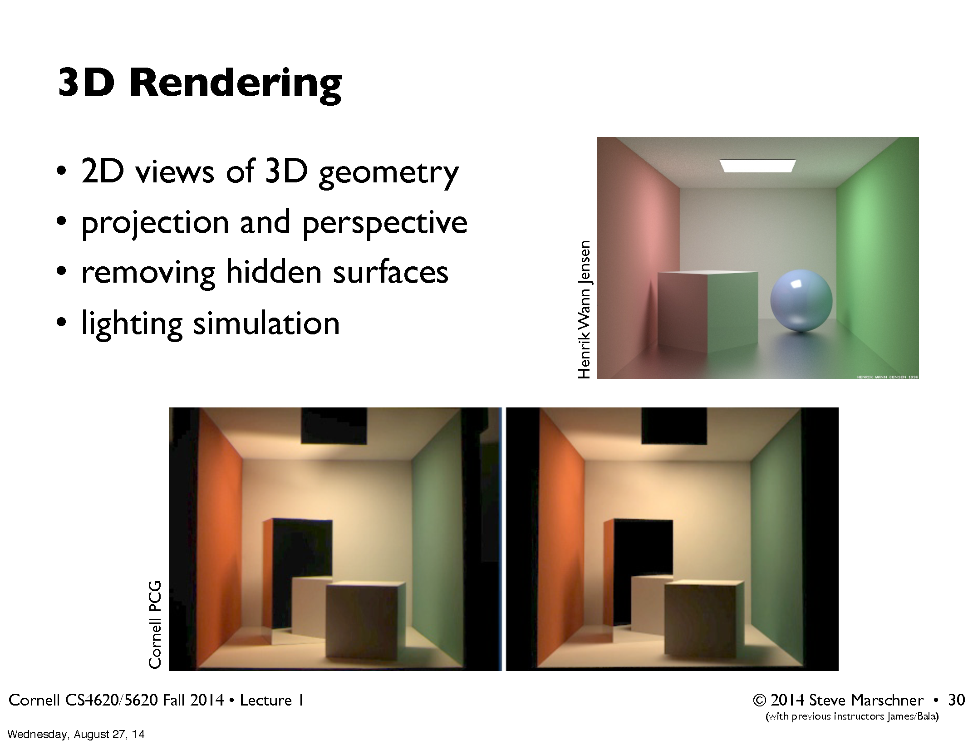

Slide 6


Slide 7
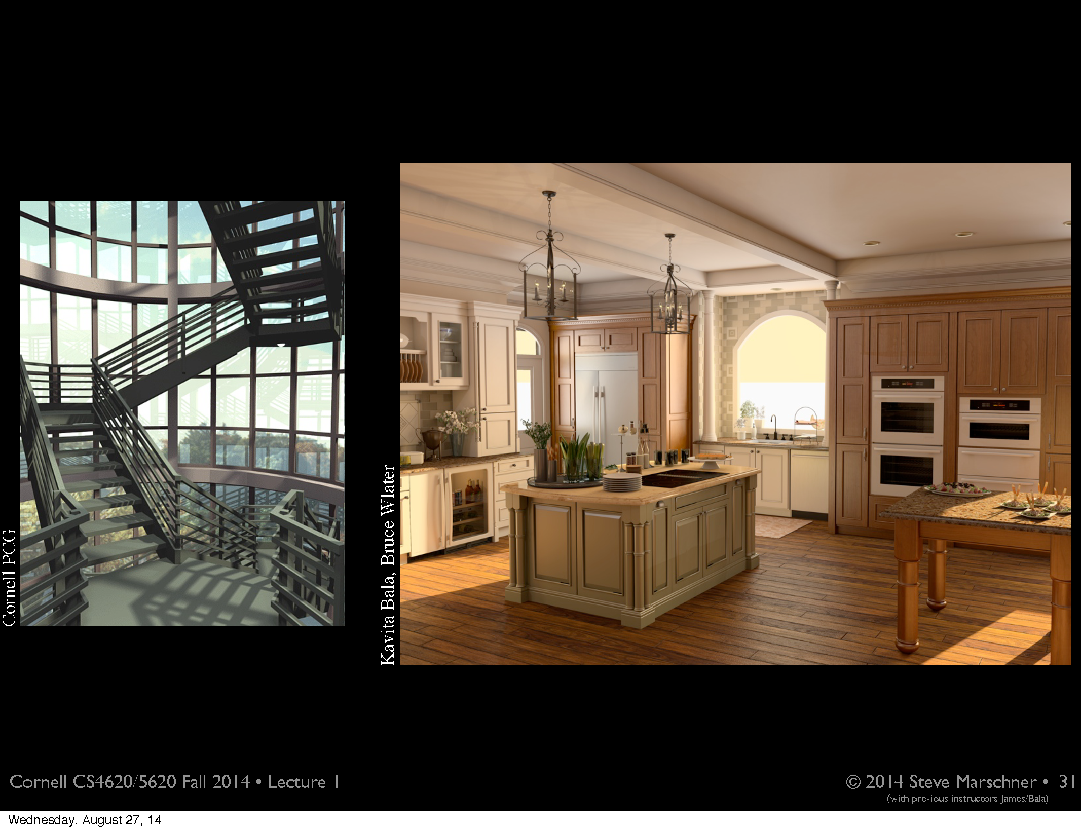

Slide 8
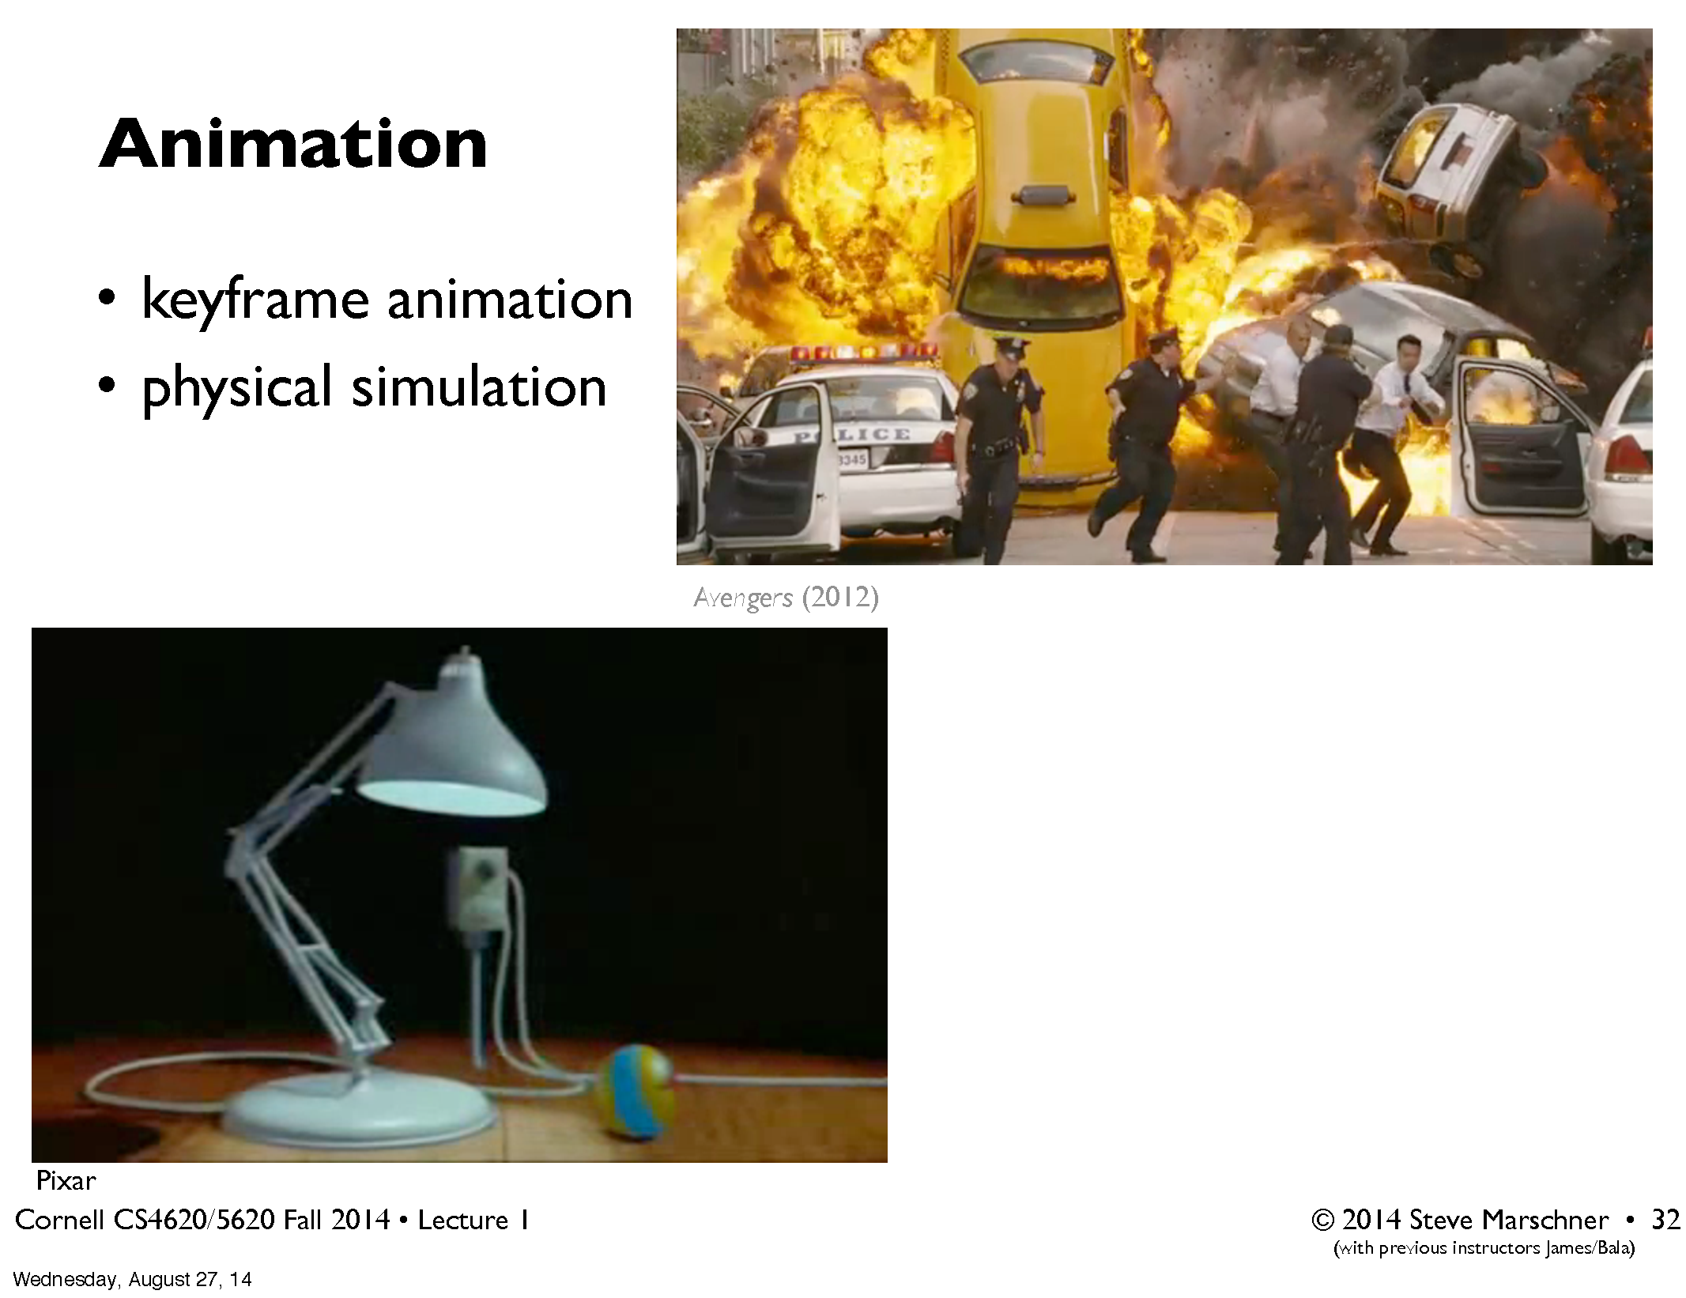

Slide 9
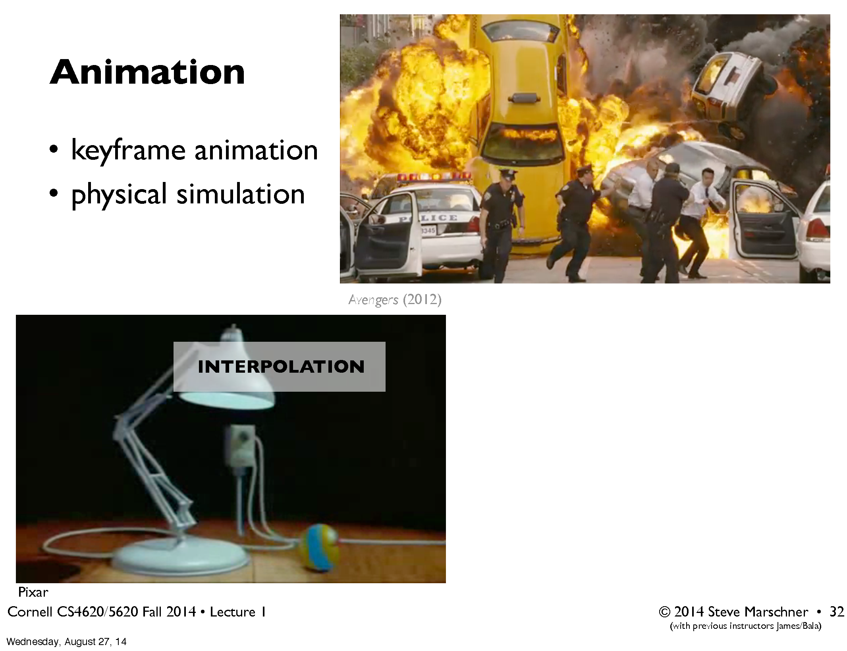

Slide 10
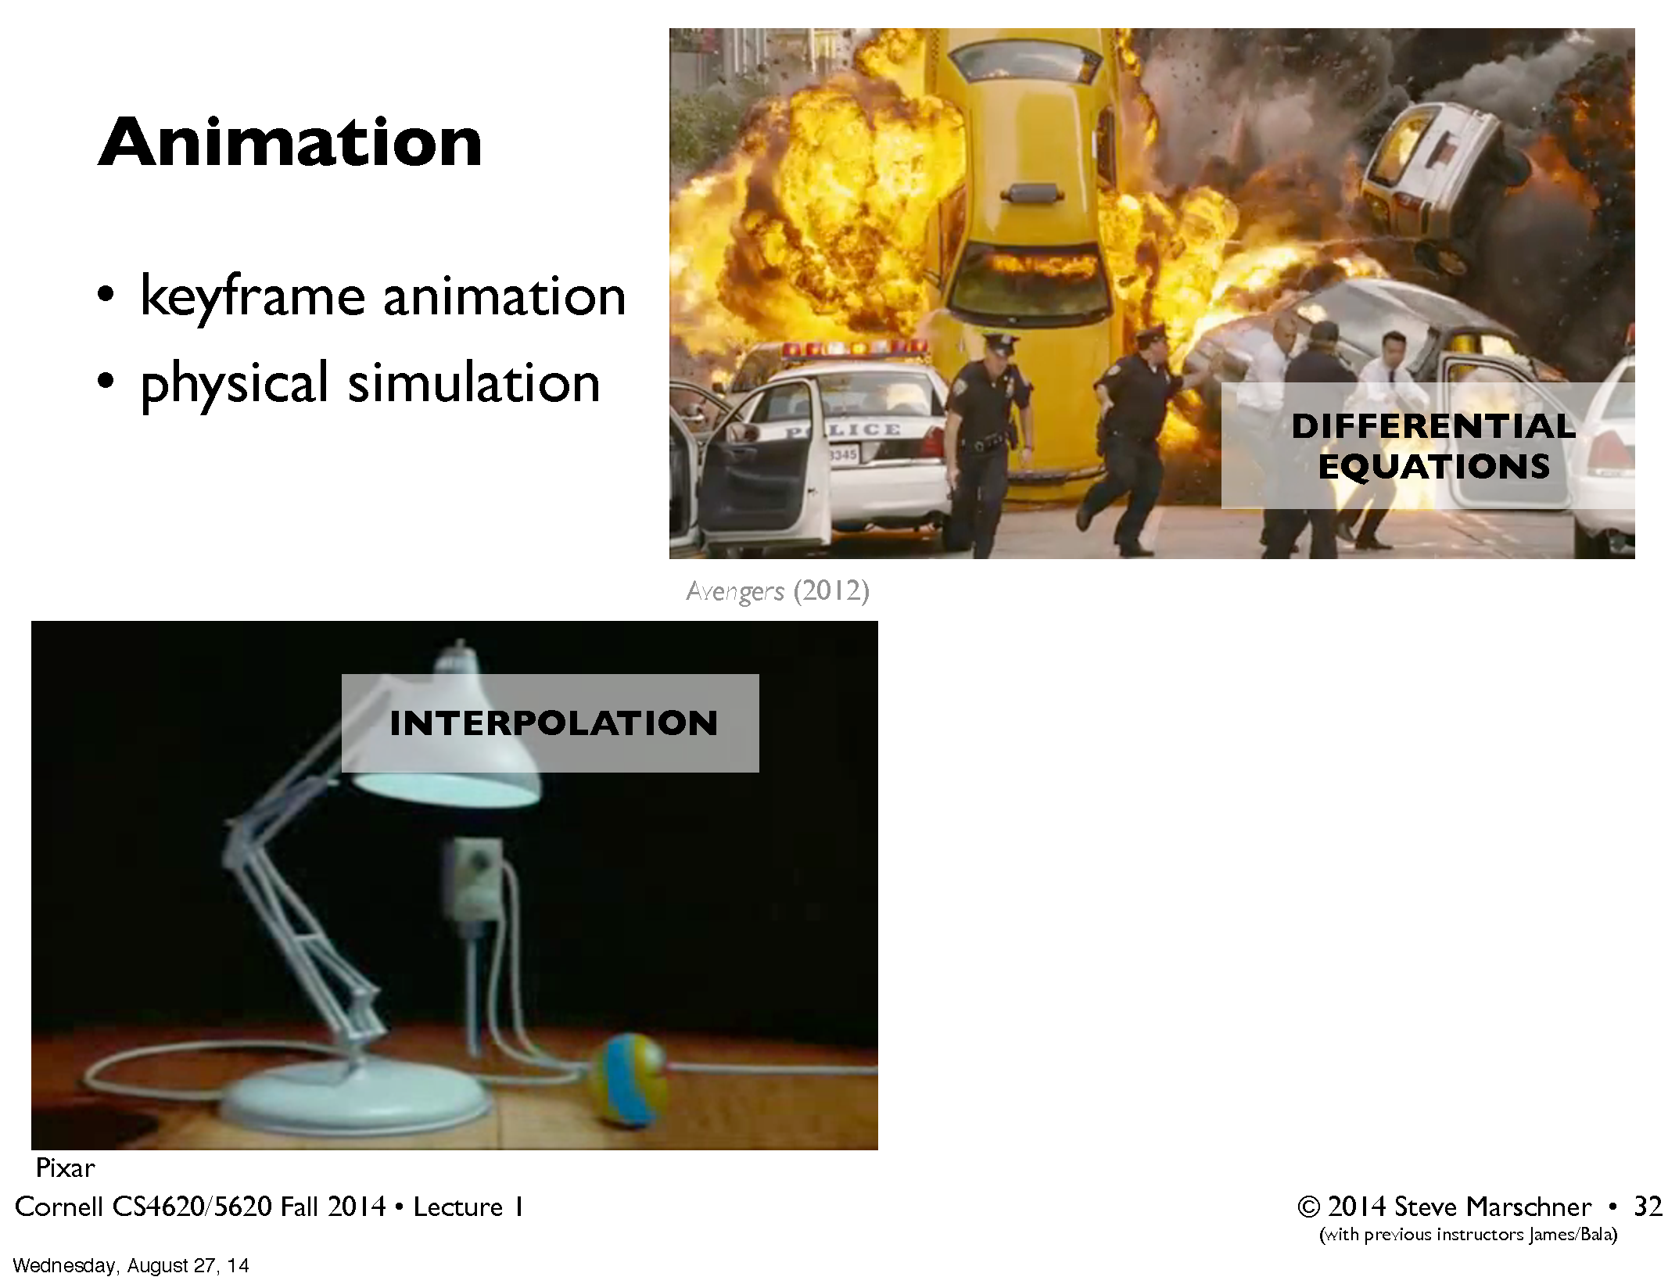

Slide 11
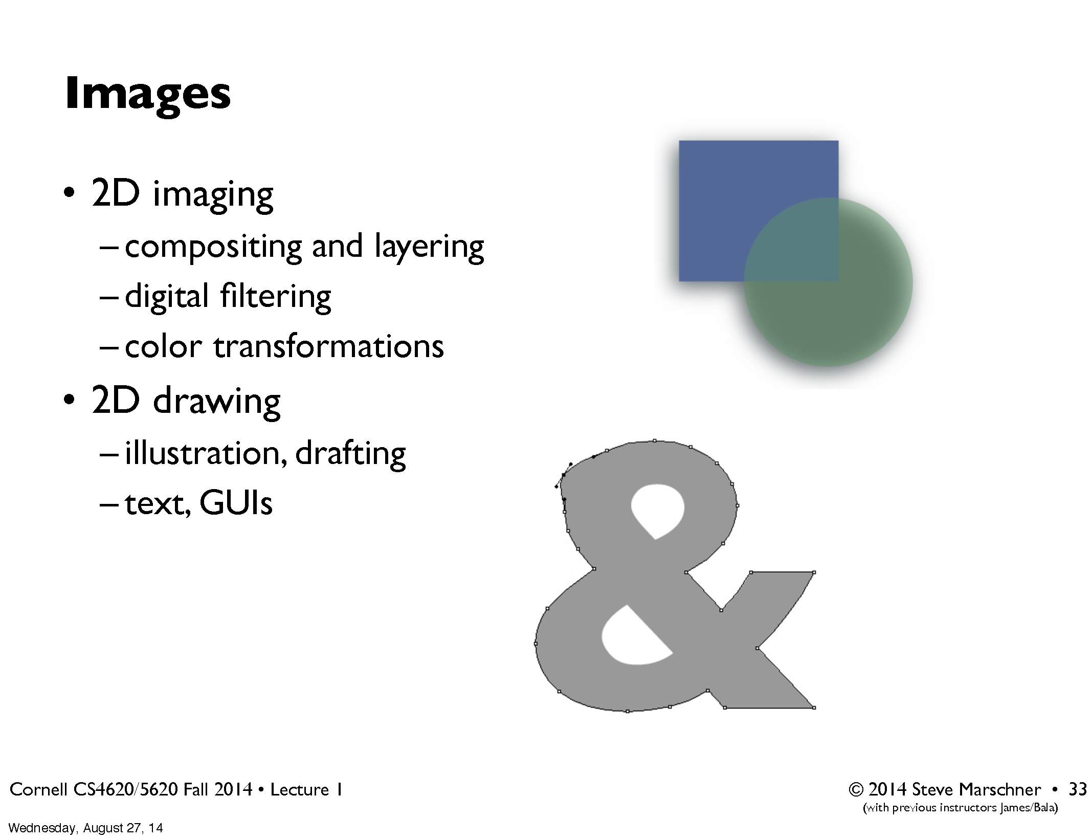

Slide 12
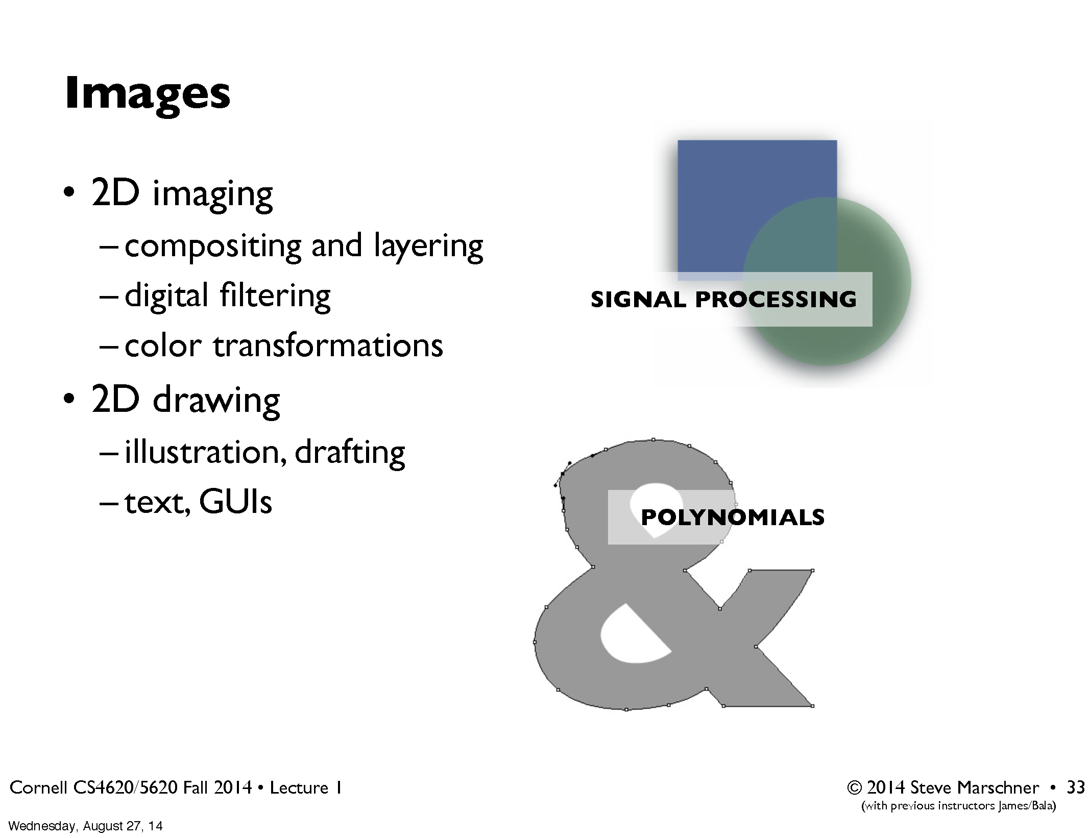

Slide 13
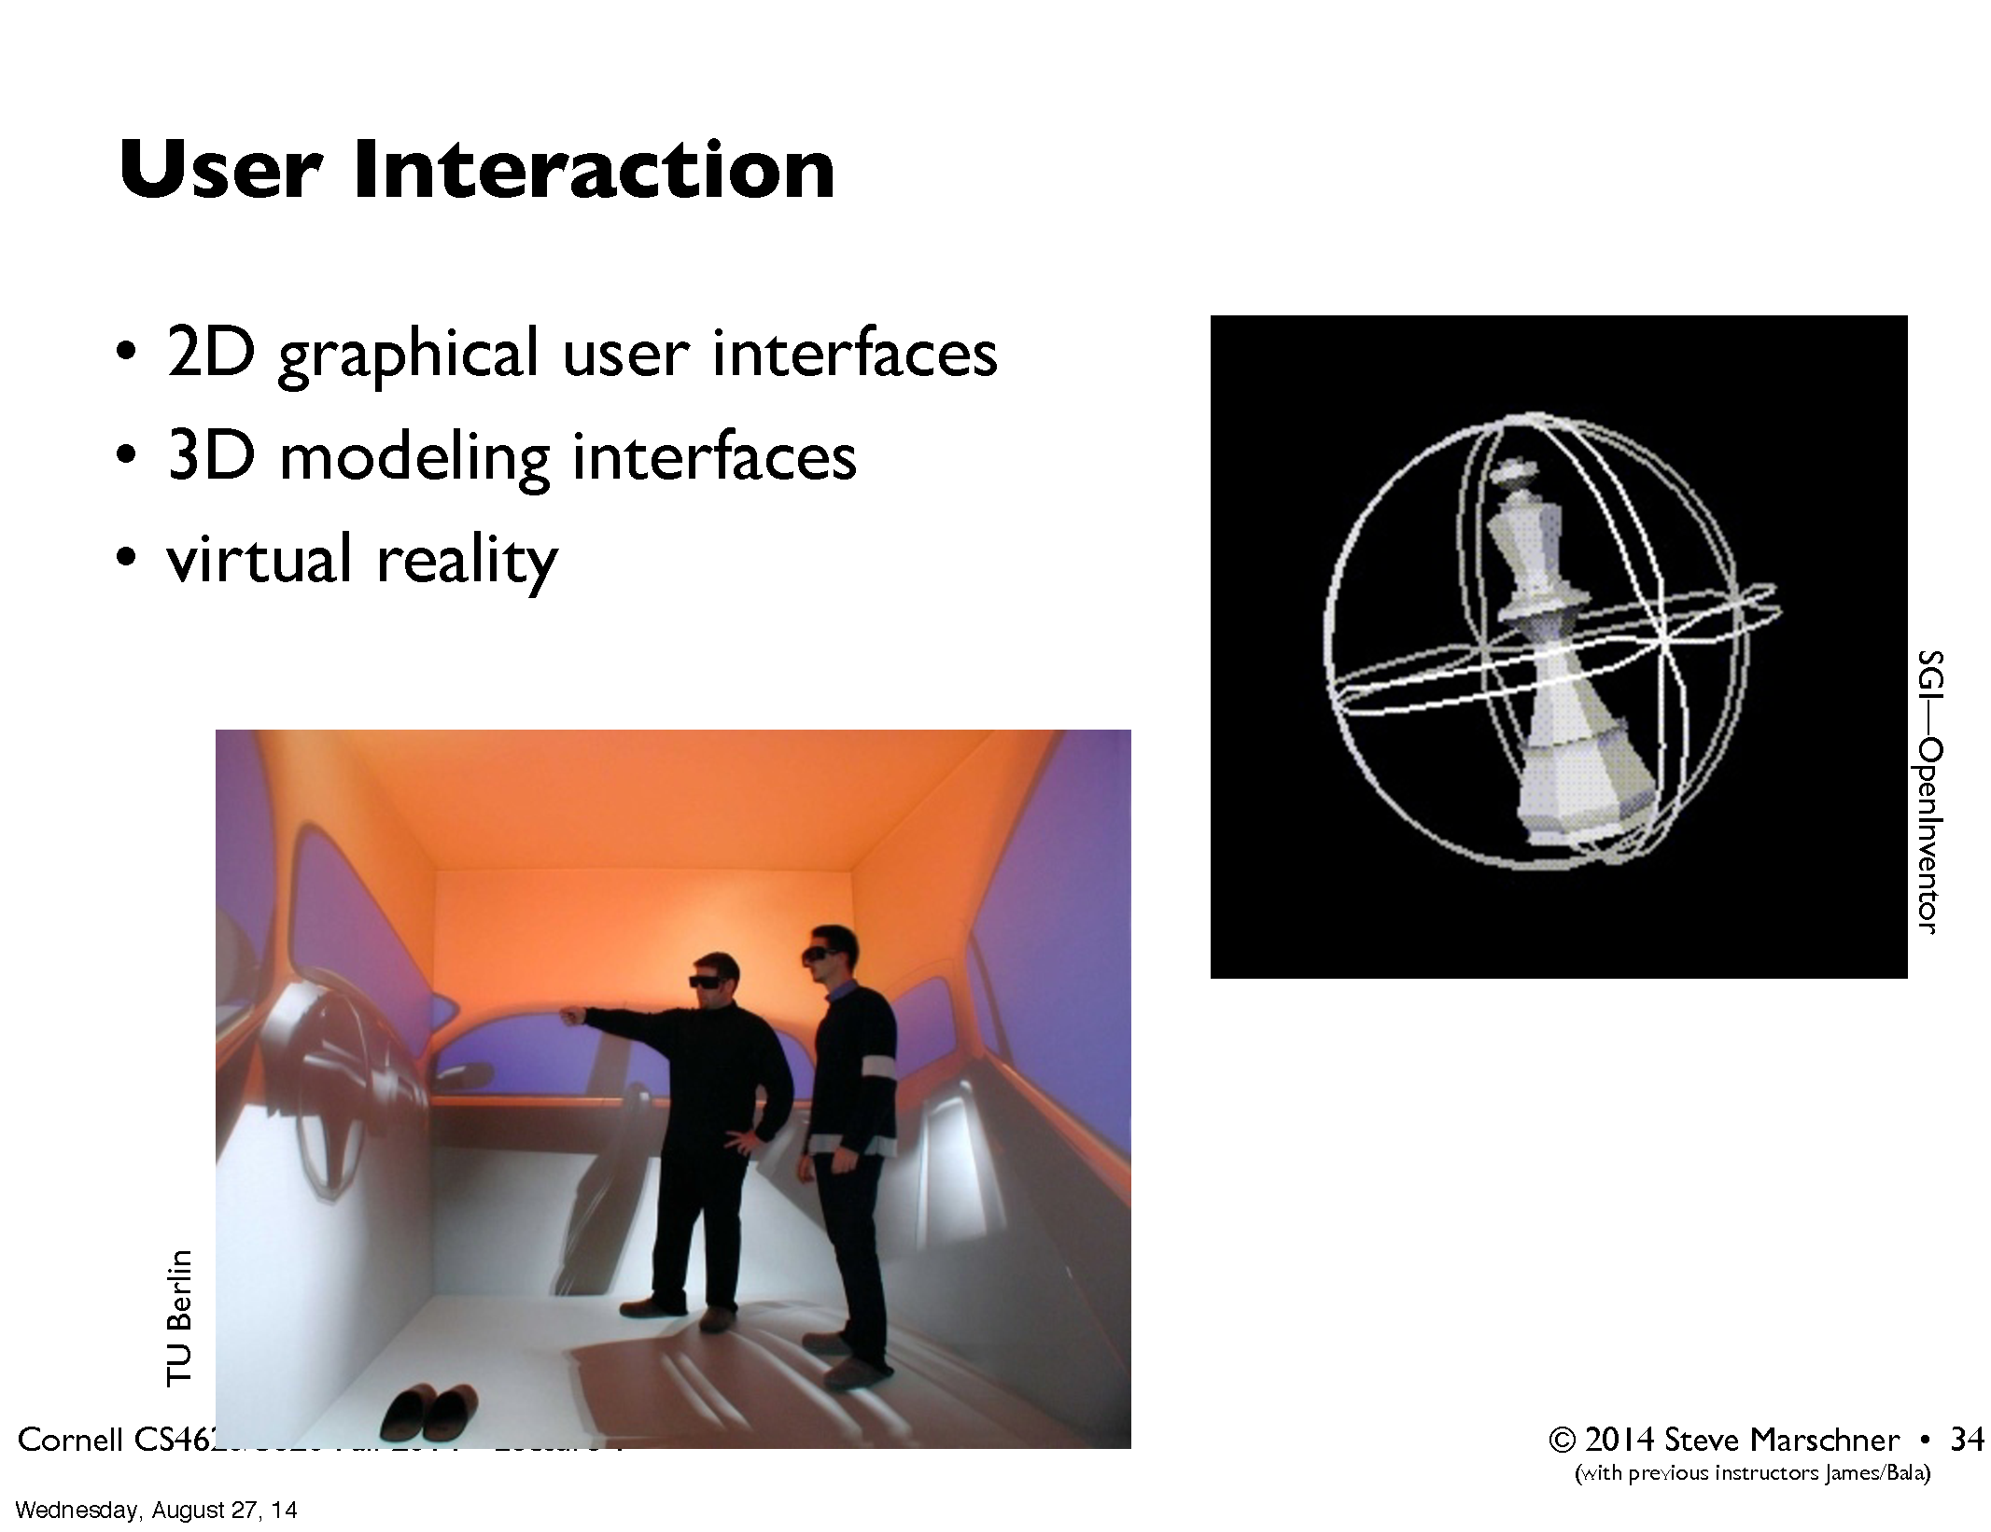

Slide 14
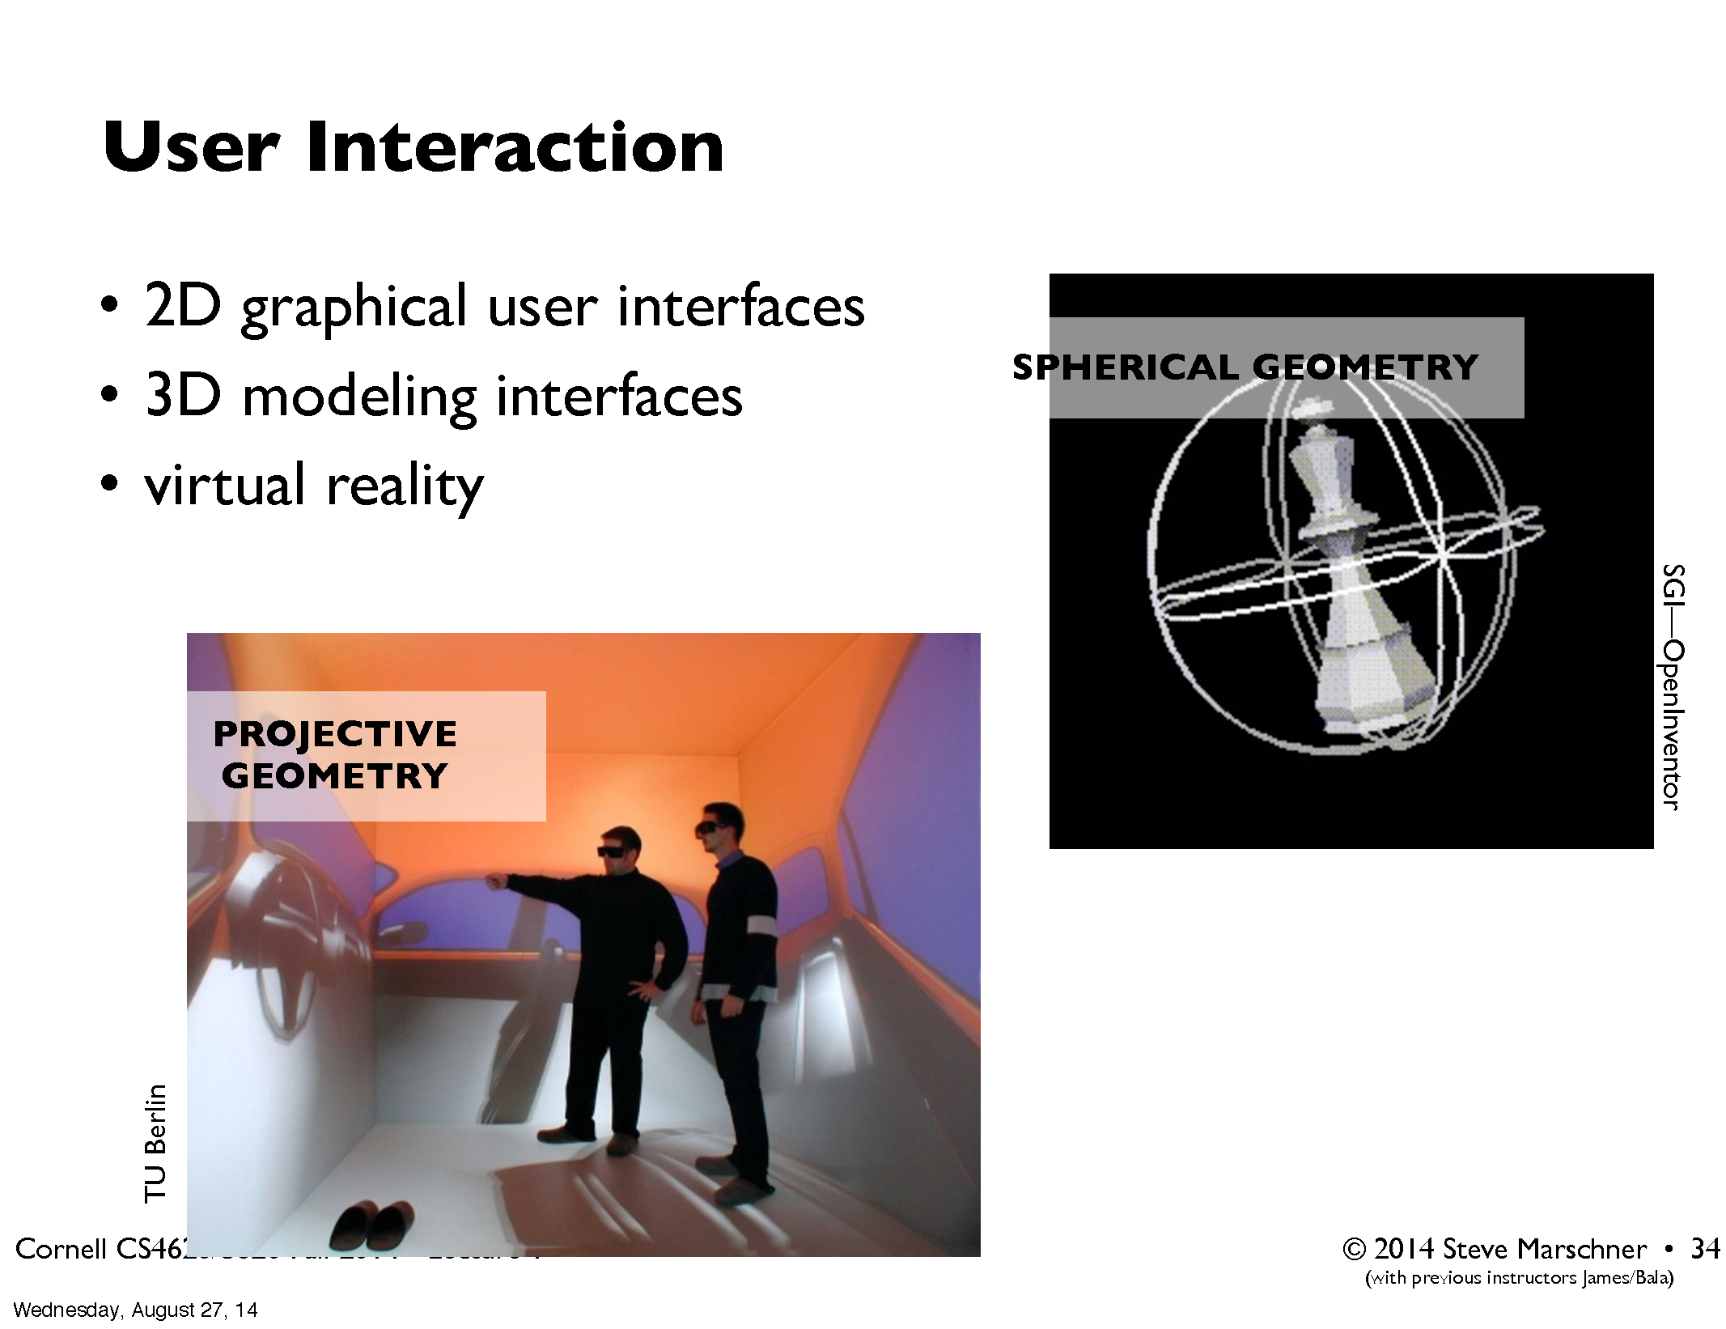

Slide 15
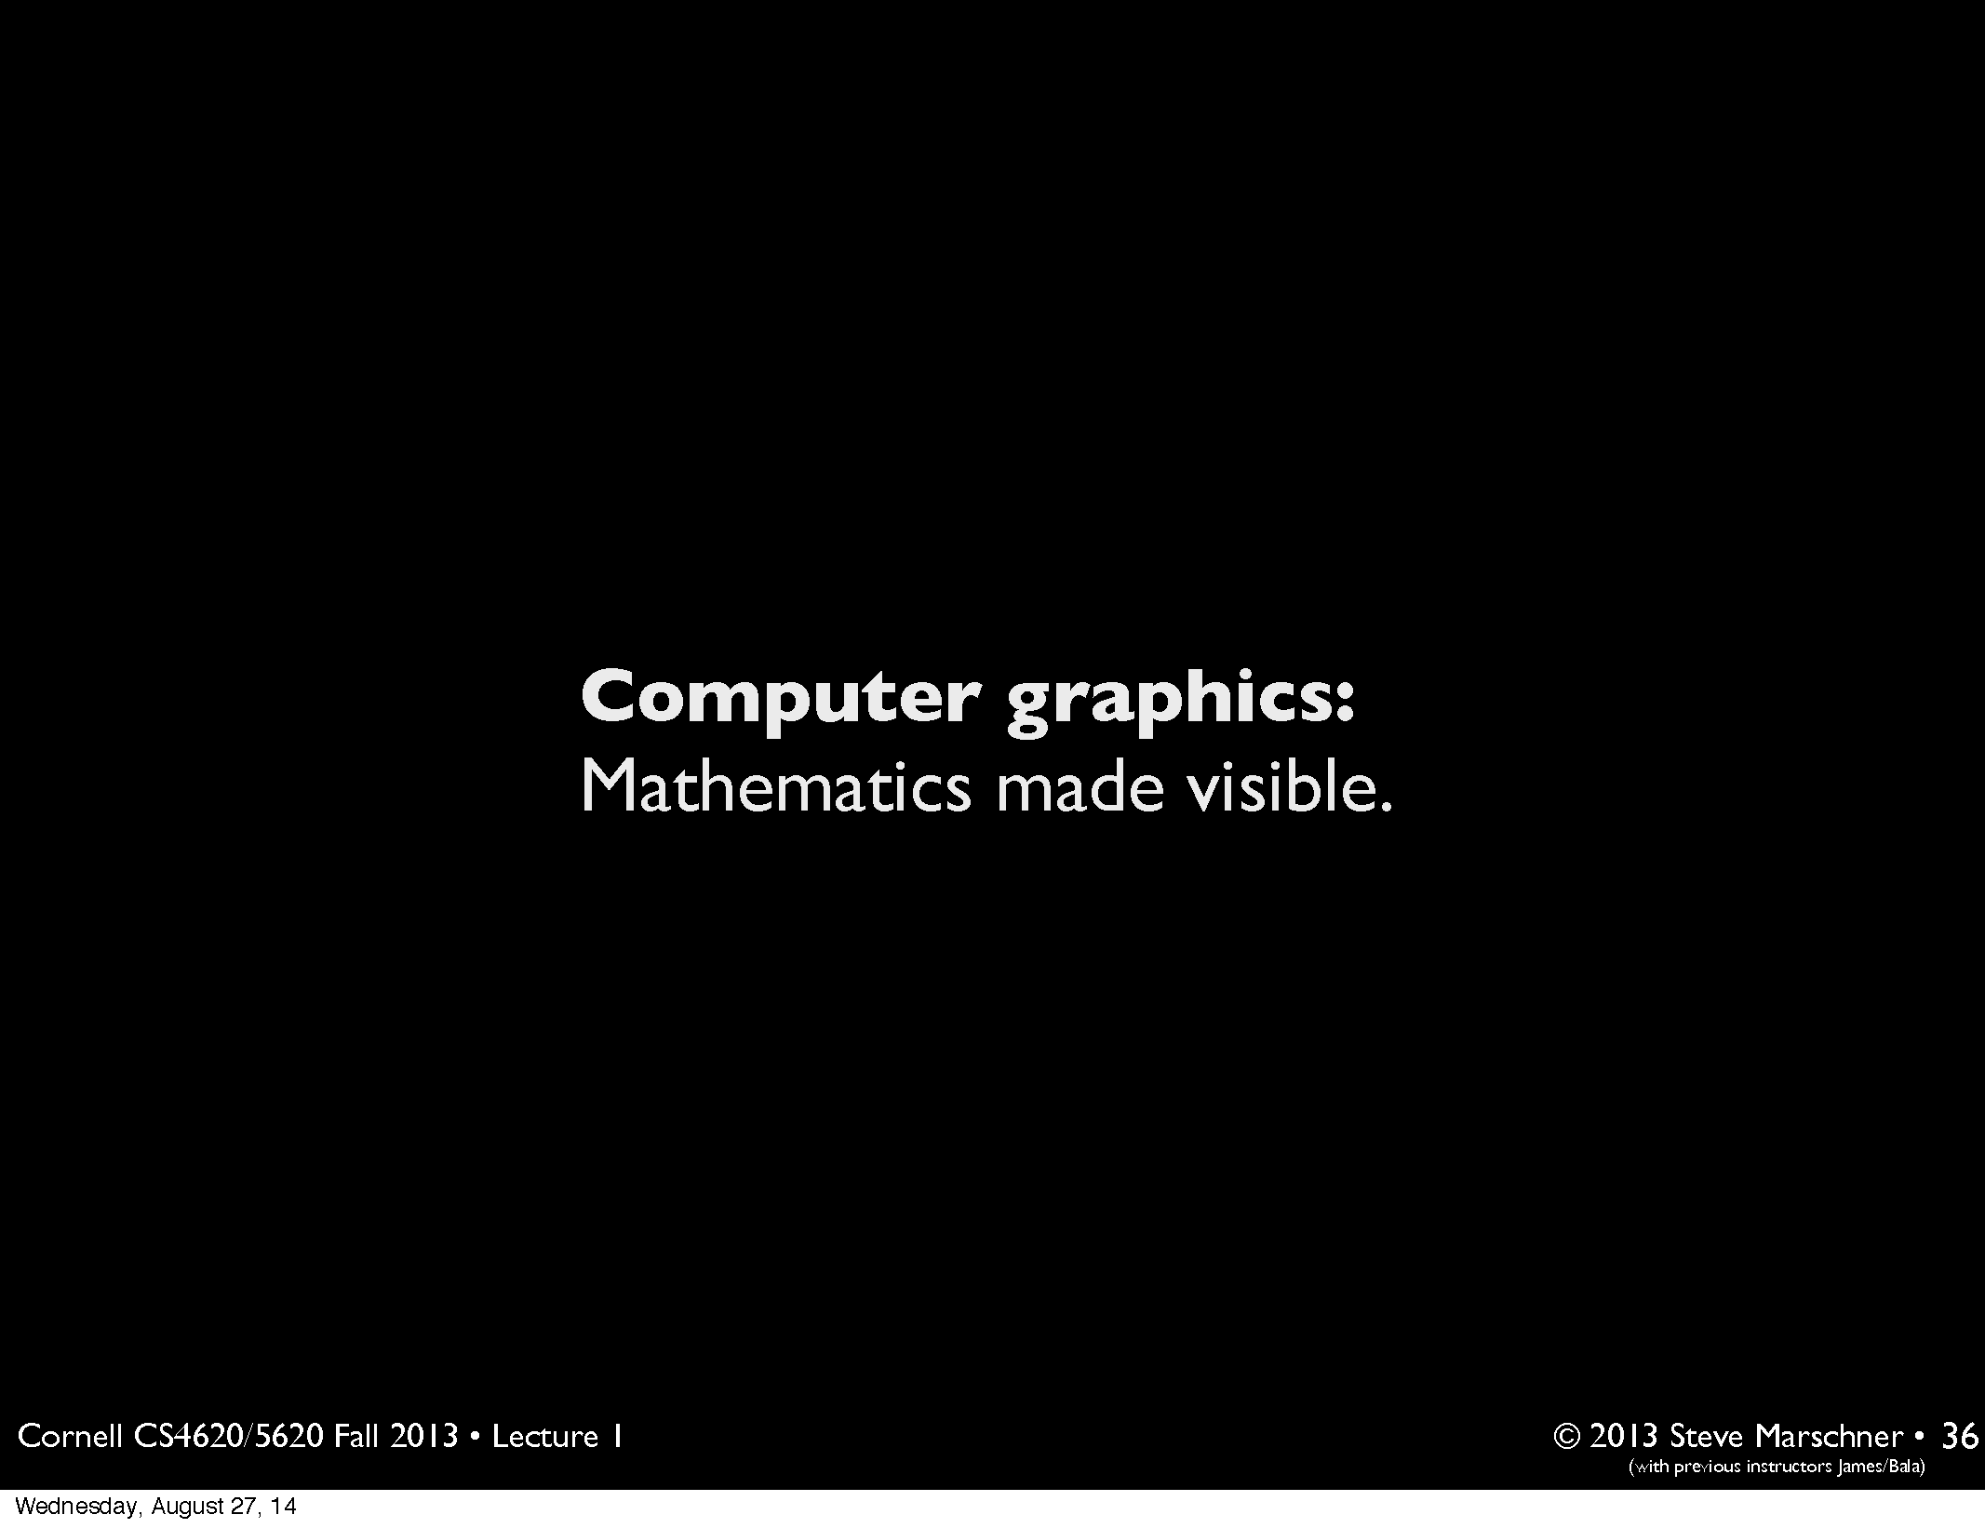

Slide 16
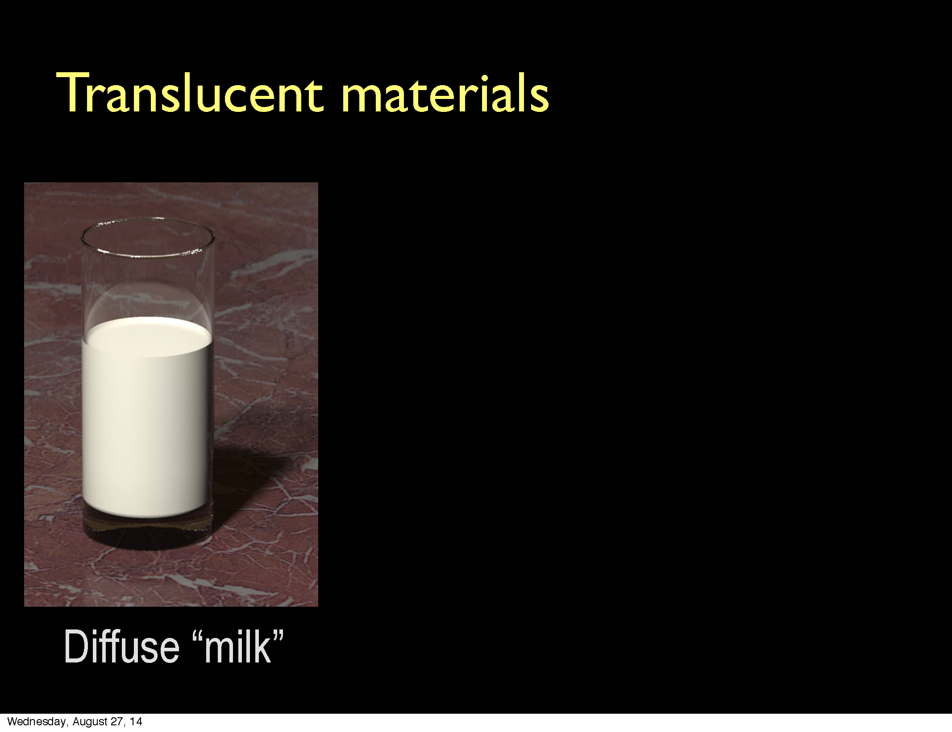

Slide 17
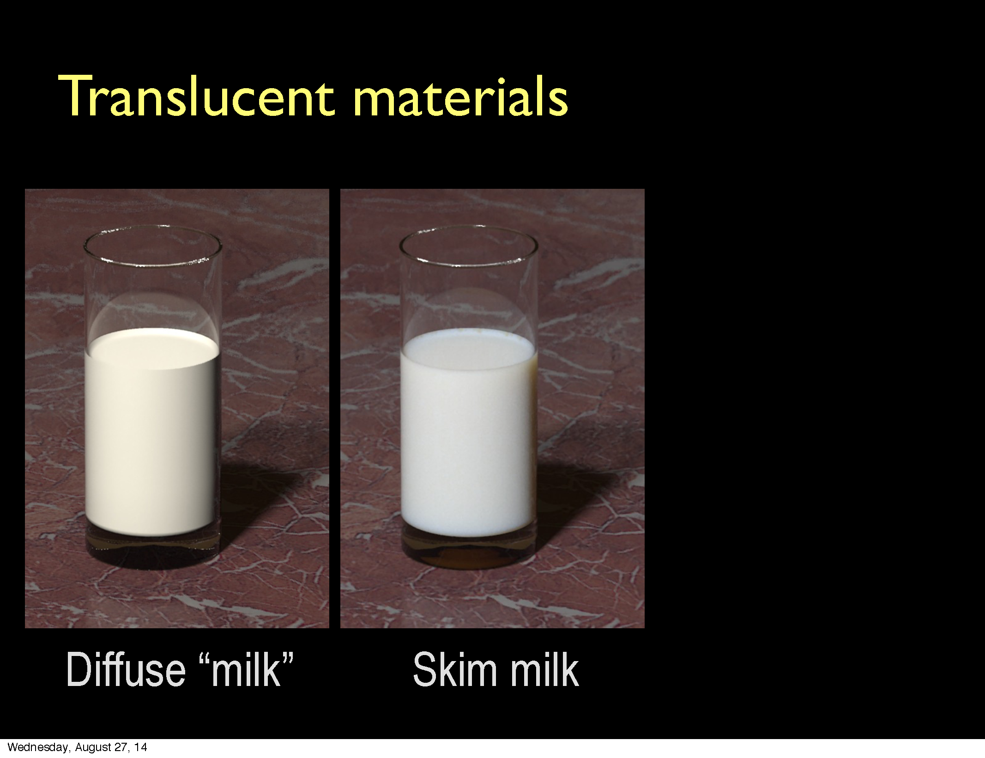

Slide 18
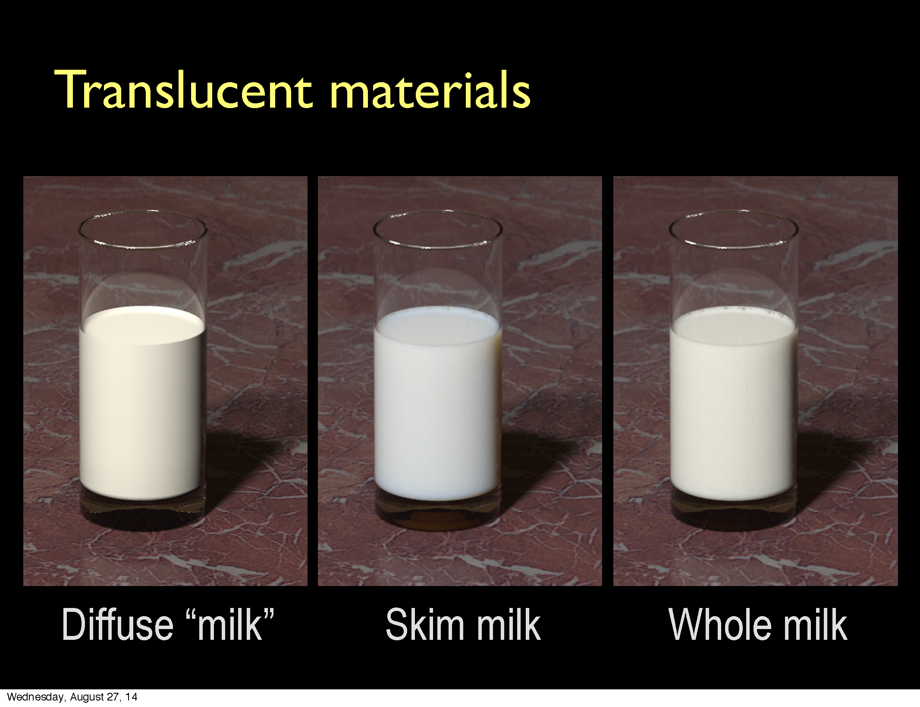

Slide 19
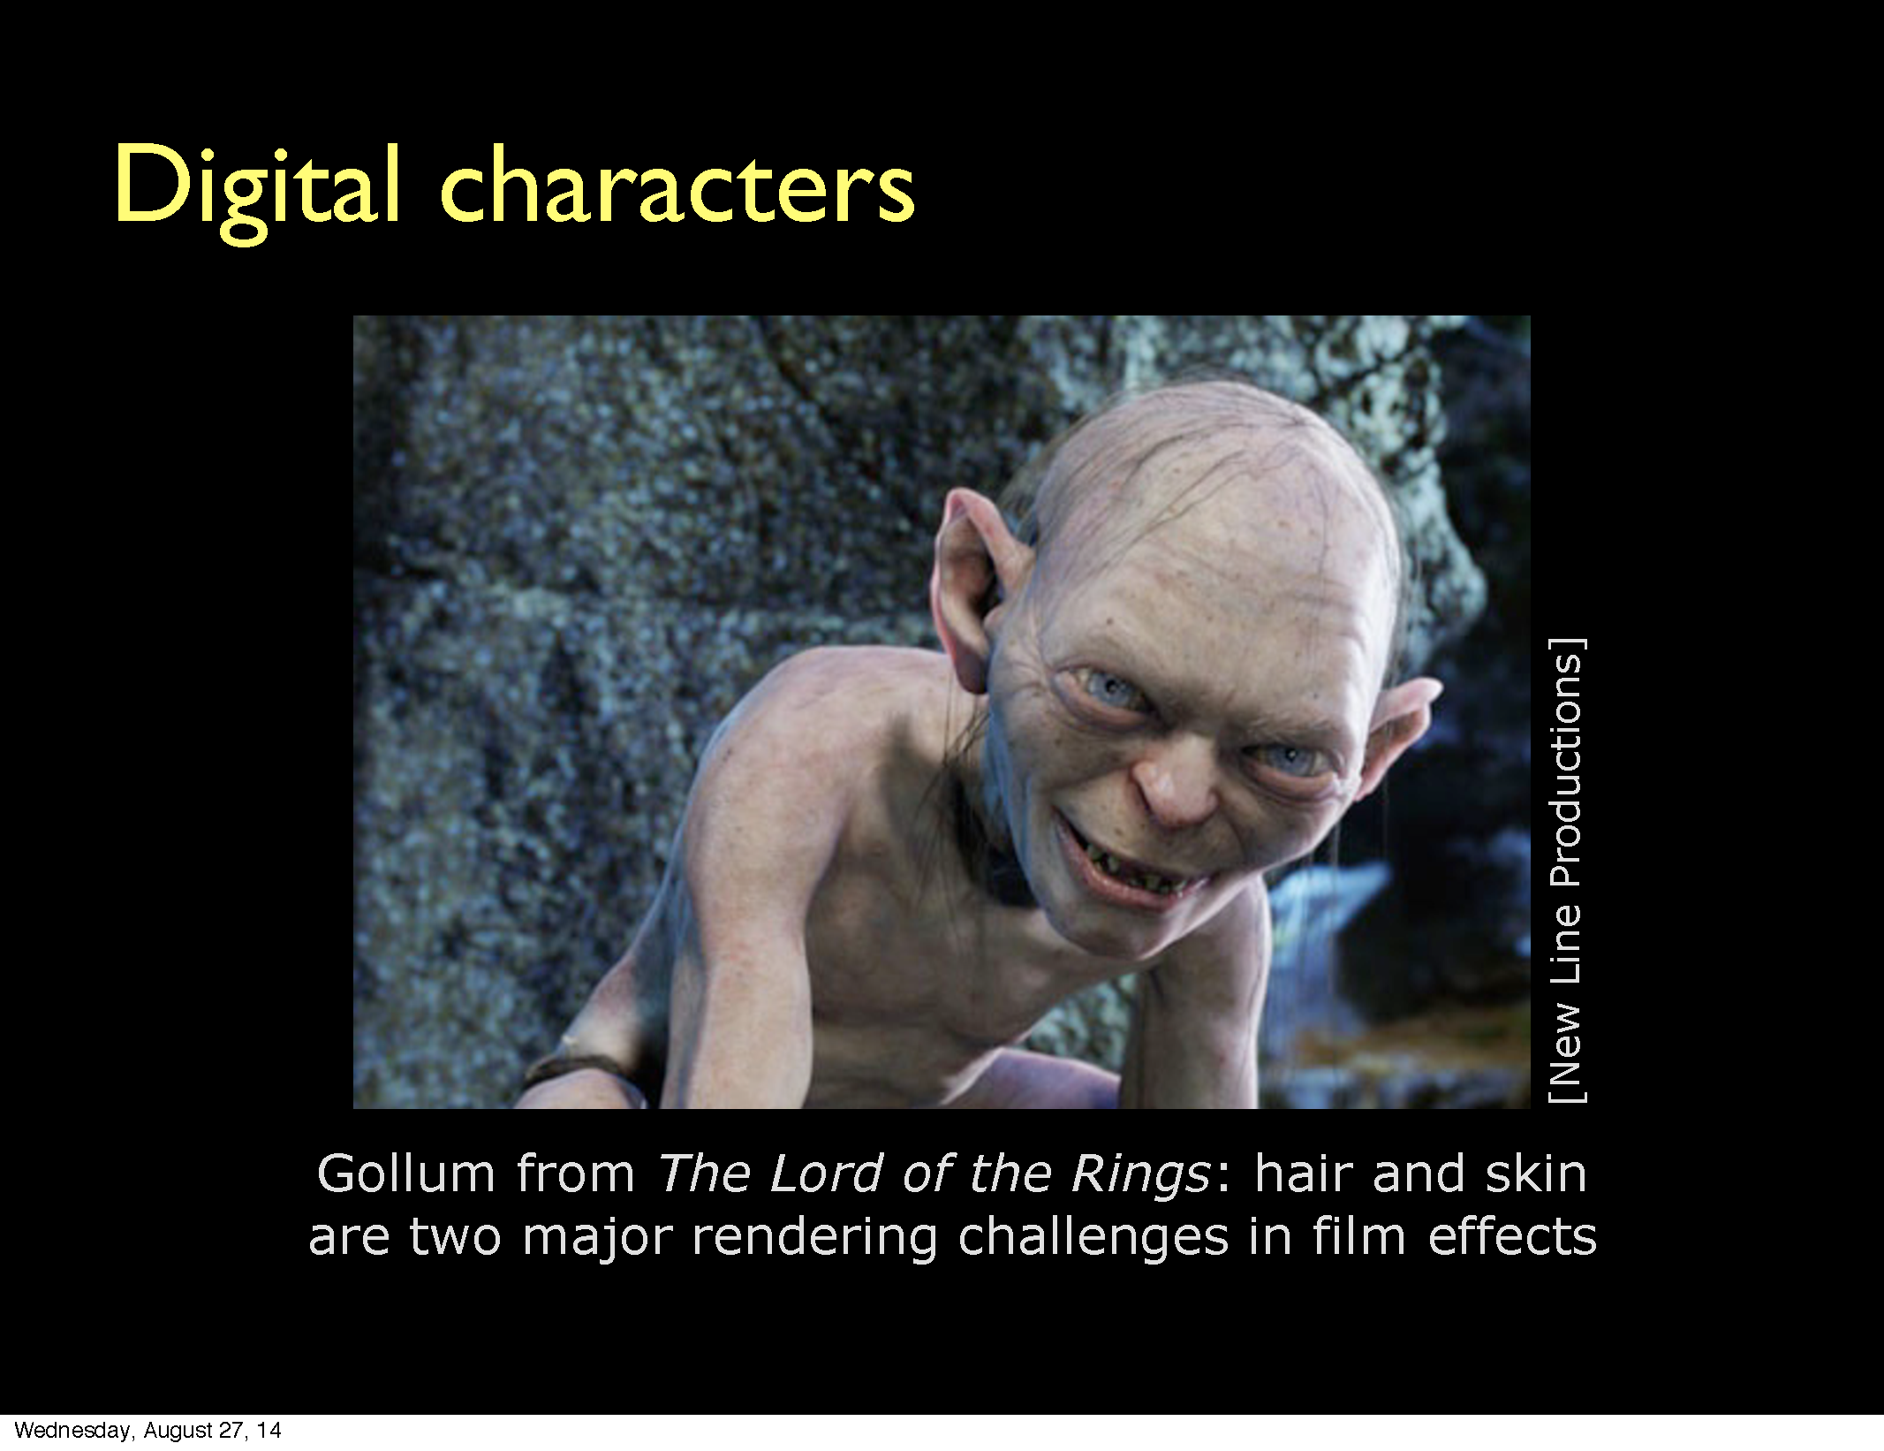

Slide 20
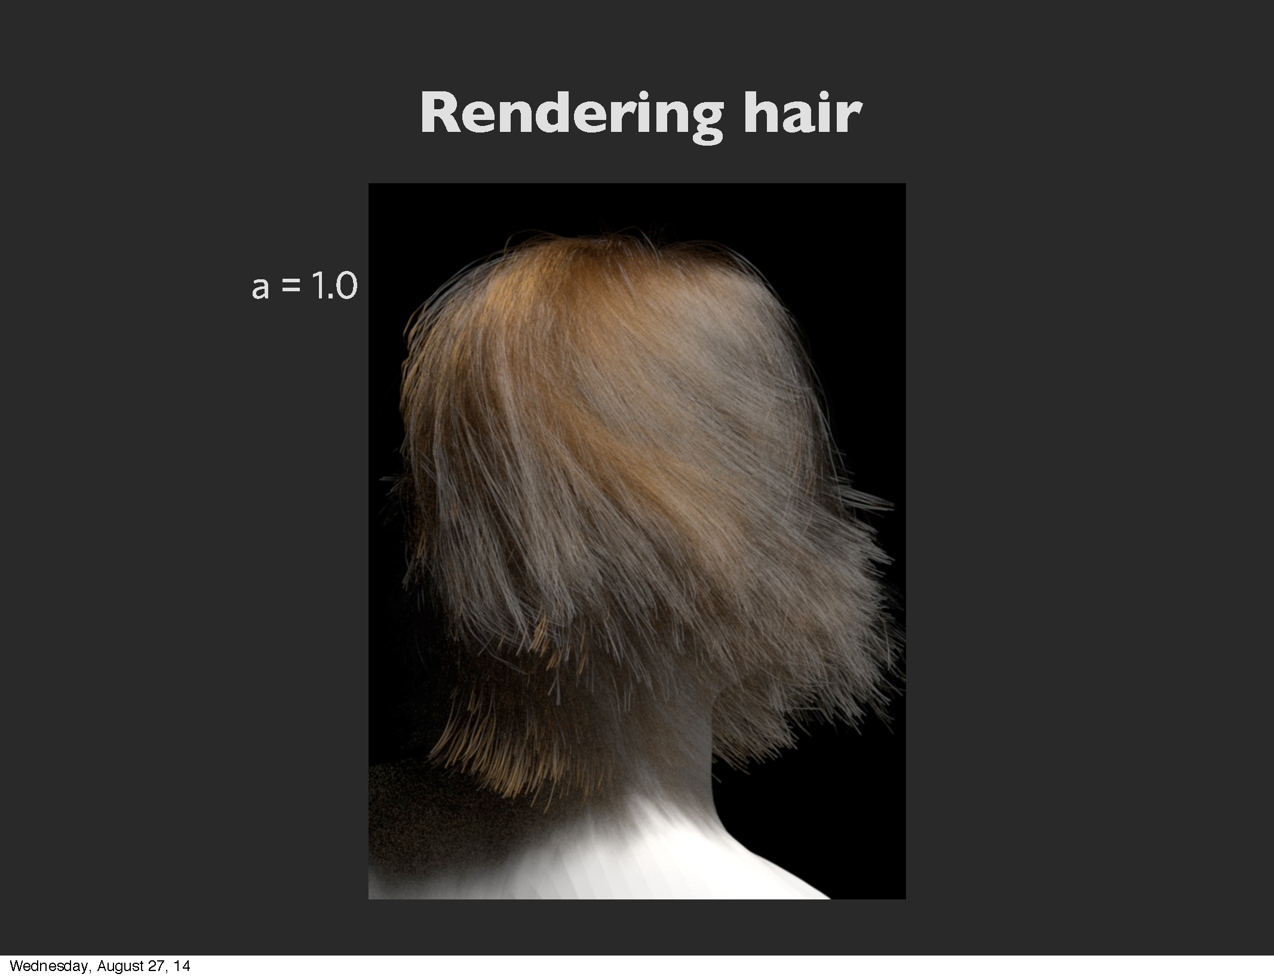

Slide 21
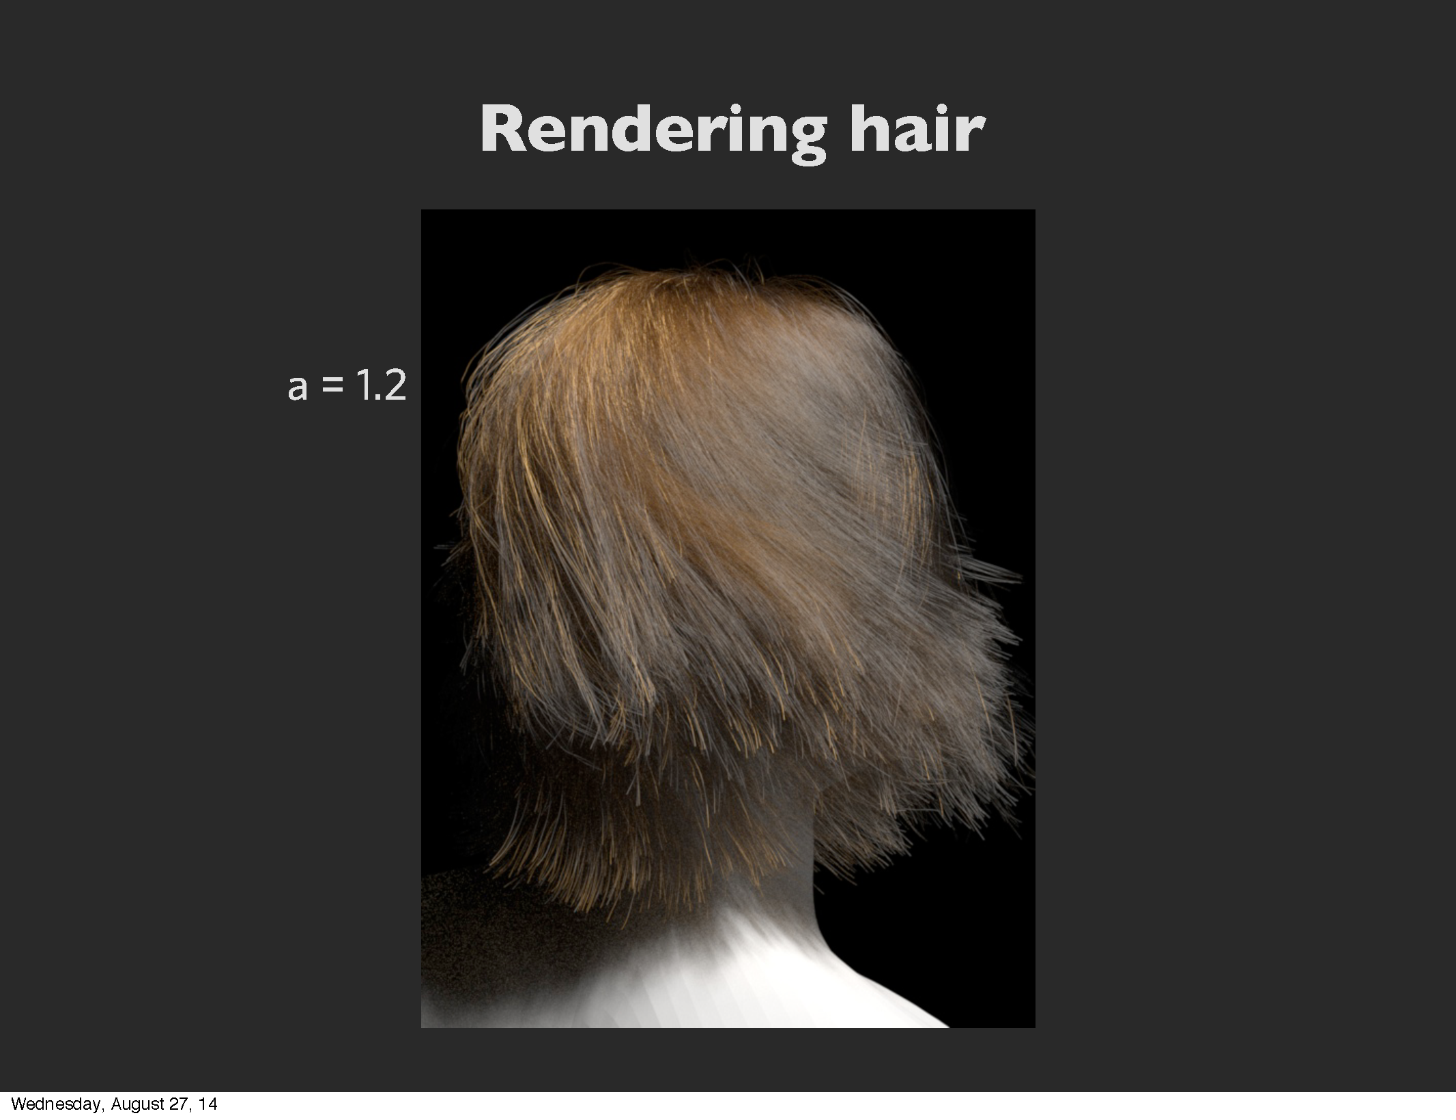

Slide 22
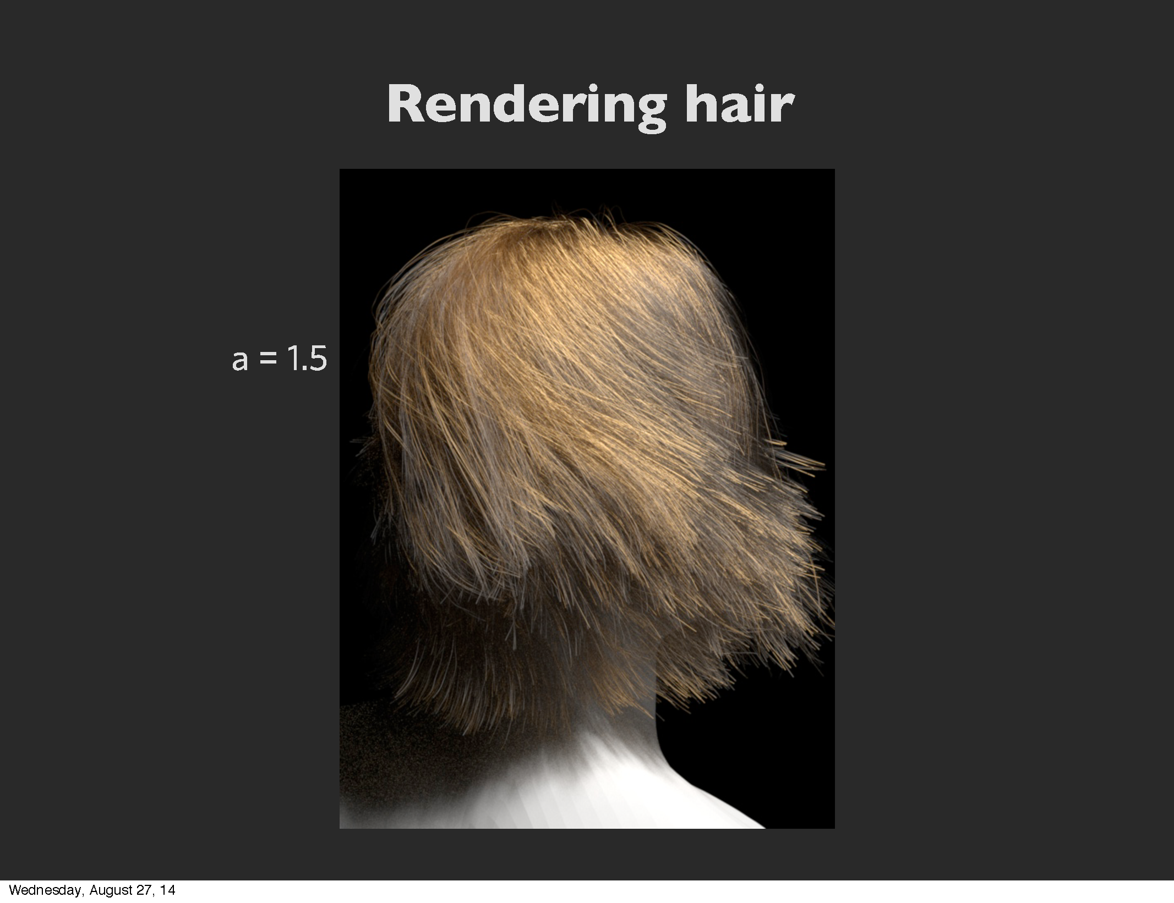

Slide 23
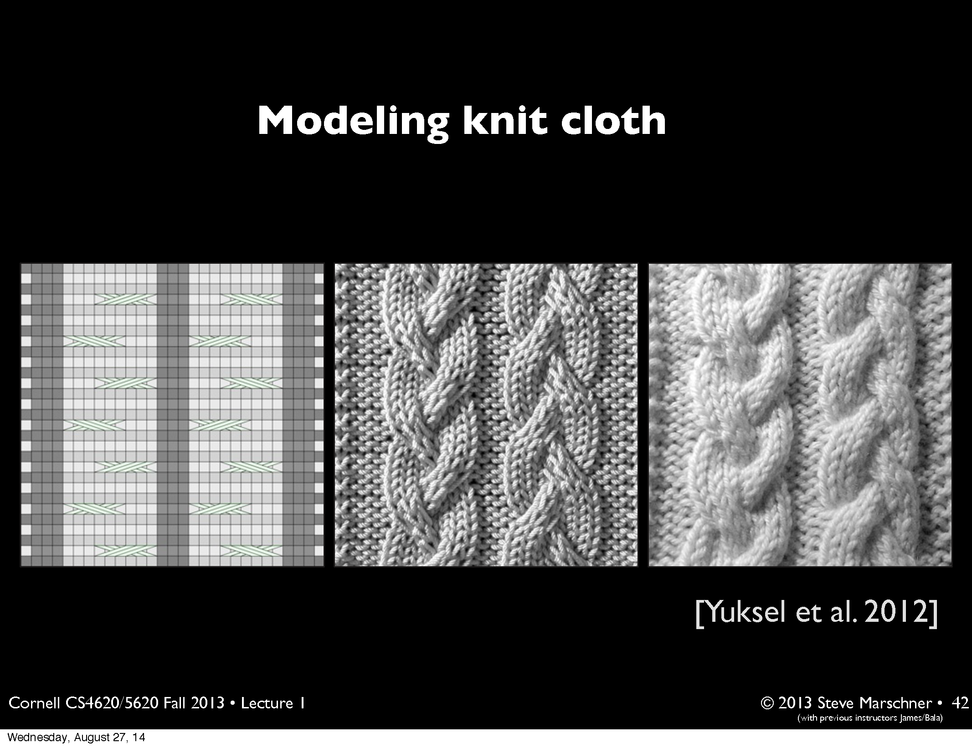

Slide 24
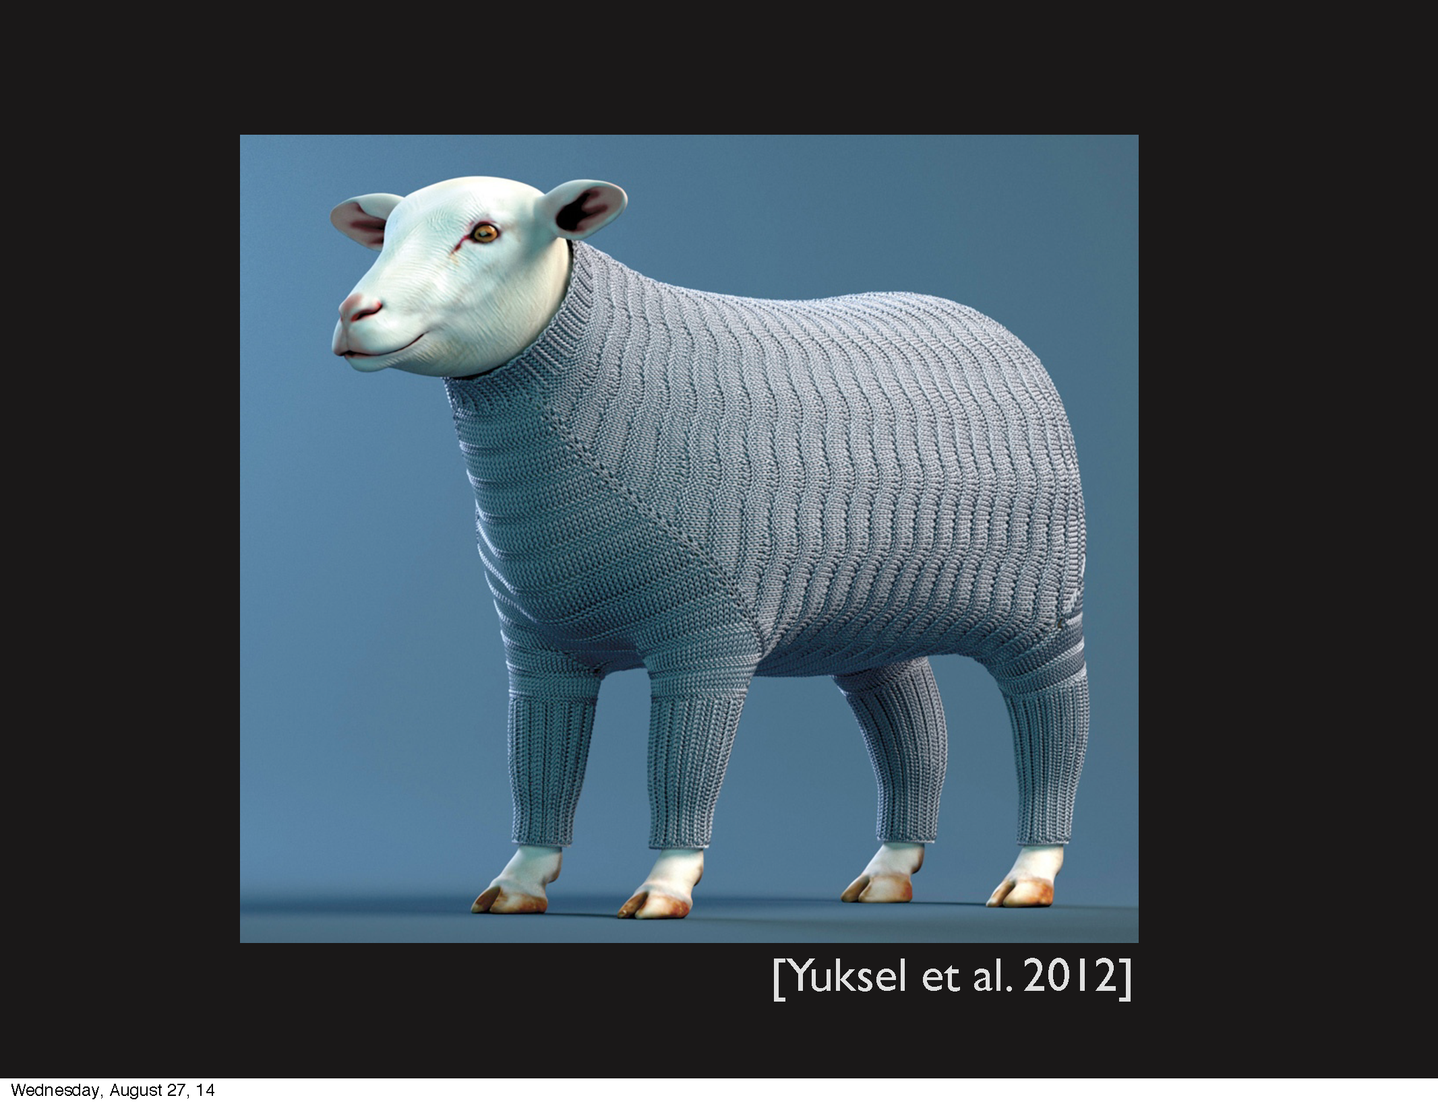

Slide 25
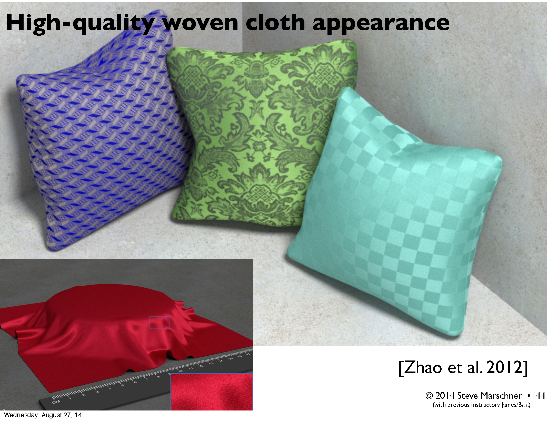

Slide 26
Aspects of Graphics
Design vs. Programming
Interactive vs. Photorealistic
2D vs. 3D
Graphics vs. image processing vs. user interfaces

Slide 27
Forces Driving Improvements in Computer Graphics
Computer
Graphics
Embarrassing Parallelism of
Graphics
Increasing Semiconductor
Density
Particularly the
hardware-amenable,
latency tolerant
nature of rasterization
Moore’s
Law
Human desire for Visual
Intuition and Entertainment
Particularly
interactive video games

Slide 28
Enabling Modern Computer Graphics
Hardware revolution
Moore’s Law: every 12-18 months, computer power improves by factor of 2 in price / performance as feature size shrinks
Significant advances in commodity graphics chips every 6 months vs. several years for general purpose CPUs
NVIDIA GTX Titan Z… 8122 gigaflops
Newest CPUs are 64-bit, 2, 4, 6, 8, or 10 core
Intel Core i7 – consumer, up to 6 cores hyperthreaded to provide 12 threads
Intel Haswell – industrial, 8 cores HT, 16 threads

Slide 29
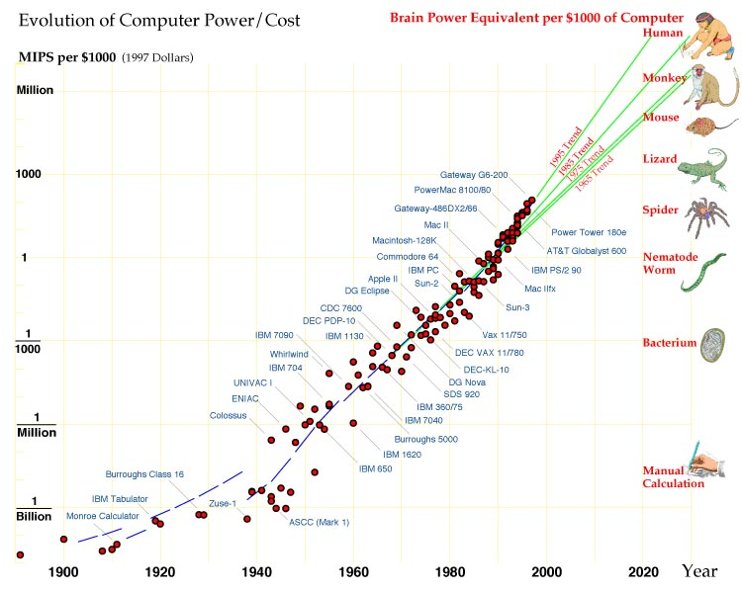
Intelligence Chart
Notes:
What visual argument does this graph make? (Ray Kurzweil)
What is Moore's law actually? It only applies to transistor count.

Slide 30
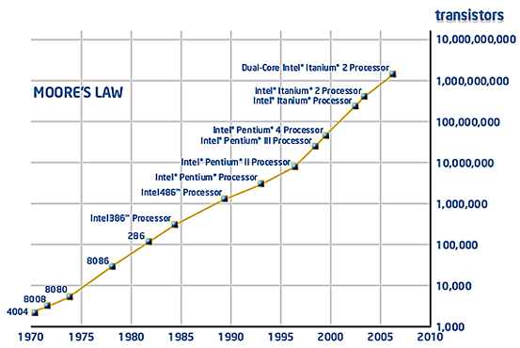
http://web.sfc.keio.ac.jp/~rdv/keio/sfc/teaching/system-software/system-software-2008-prod/mooreslaw_graph2-intel.gif
Notes:
Transistor count is still growing. What's happening to performance? Power consumption?

Slide 31
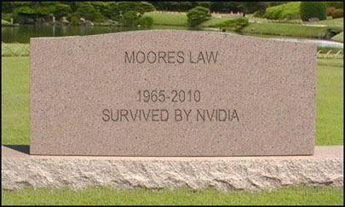
Nvidia: Moore's Law is Dead, Multi-core Not Future
Notes:
According to NVidia, the future is not a few cores optimized for serial performance speed, it's many smaller processors optimized for power consumption.

Slide 32
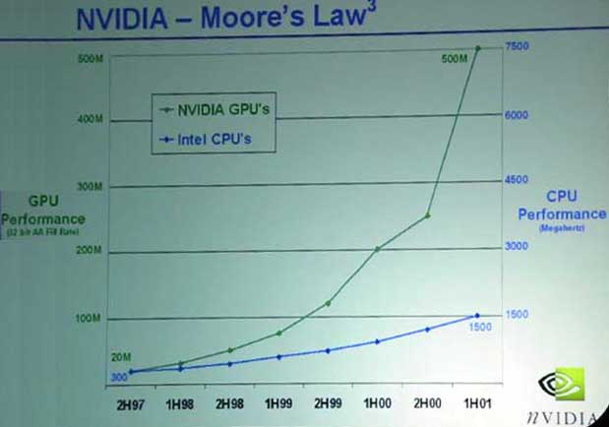
Notes:
This graph is old, but the growth of graphics processor performance has still been greatly outstripping CPUs.

Slide 33
Enabling Modern Computer Graphics
Graphic subsystems
GPU - chip designed for doing graphics operations quickly
Graphics processing from CPU to GPU
nVidia GeForce™, AMD Radeon™
Increasingly, GPUs used to parallelize other types of computation
GPGPU (General-Purpose Computing on GPU)
NVIDIA GeForce GTX 460s
1.35 GHz clock, 1GB memory, 37.8 billion pixels/second fill rate
Old cards: GeForce 7300 GT: 350 MHz clock, 256 MB memory, 2.8 billion fill rate
Notes:
http://en.wikipedia.org/wiki/Comparison_of_Nvidia_graphics_processing_units#GeForce_400_Series

Slide 34
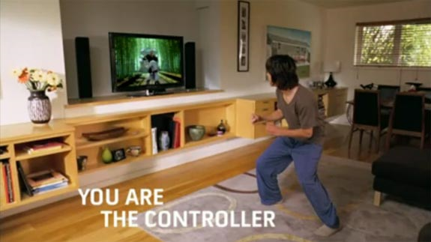
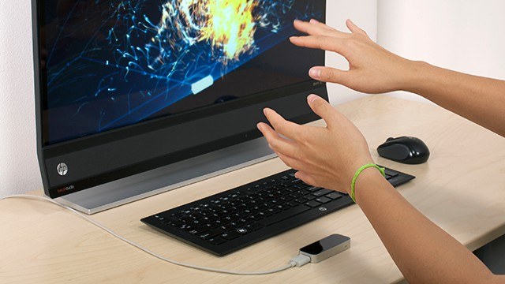
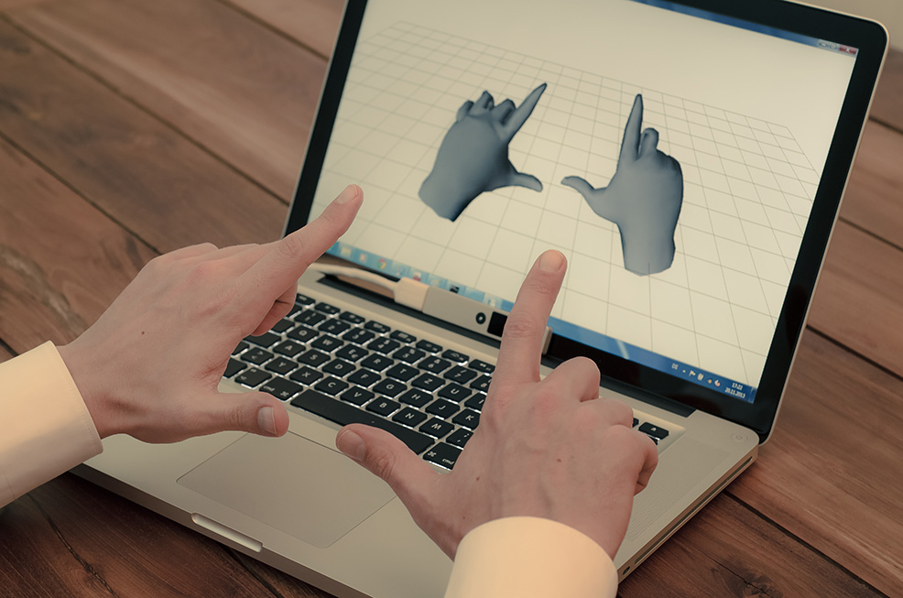
Enabling Modern Computer Graphics
Input Devices
Mouse, tablet & stylus, multi-touch, force feedback, and other game controllers (e.g., Wii), scanner, digital camera (images, computer vision), etc.
Body as interaction device
Xbox Kinect
Leap Motion
Nimble UX

Slide 35
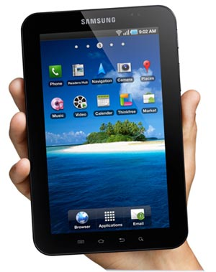
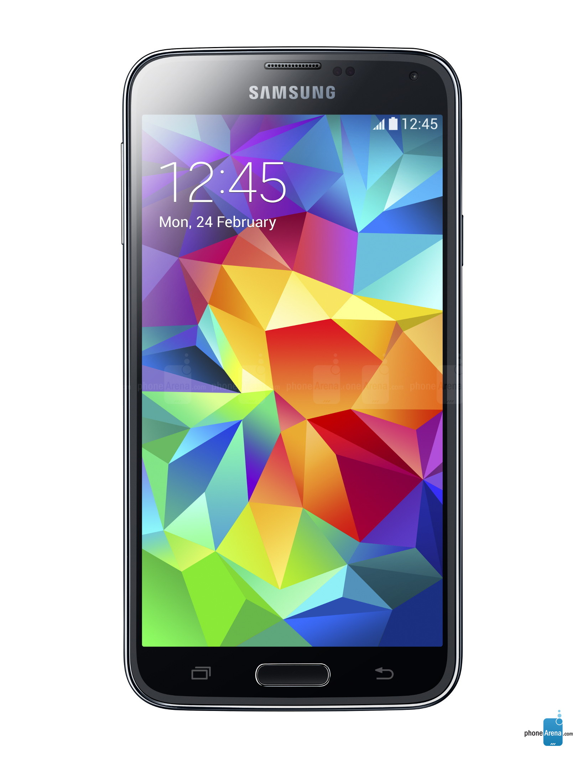
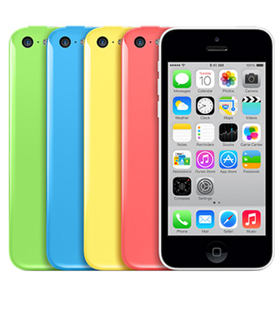

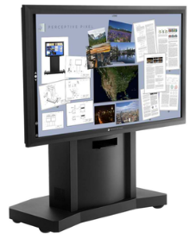

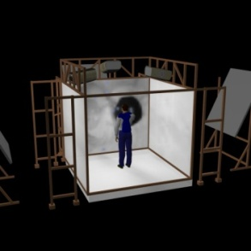
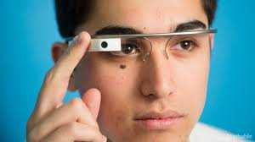
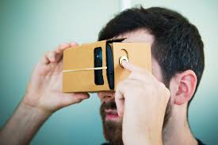
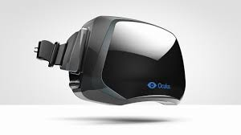
Enabling Modern Computer Graphics
Many form factors
Smartphones/laptops/desktops/tablets
Microsoft PPI display
Smart watches
Head-mounted displays (HMDs)
3D immersive virtual reality spaces
Samsung Galaxy S5
Apple iPhone
Samsung Galaxy Tab
Microsoft’s first Surface
Microsoft PPI display
Android Wear
Google Glass
Oculus Rift
Google Cardboard
Brown’s old Cave

Slide 36
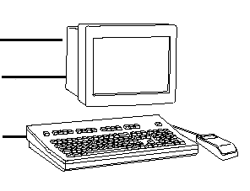
Conceptual Framework for Interactive Graphics
Graphics library/package
Intermediary between application and display hardware (Graphics System)
Application maps objects to views (images) by calling graphics library.
Application model may contain lots of non-graphical data (e.g., non-geometric object properties)
User interaction results in modification of image and/or model
Hardware/software has 5 decades but is still useful
Software
Hardware
Graphics
System/
GPU
Graphics
Library
Application
program
Application
Model / database

Slide 37
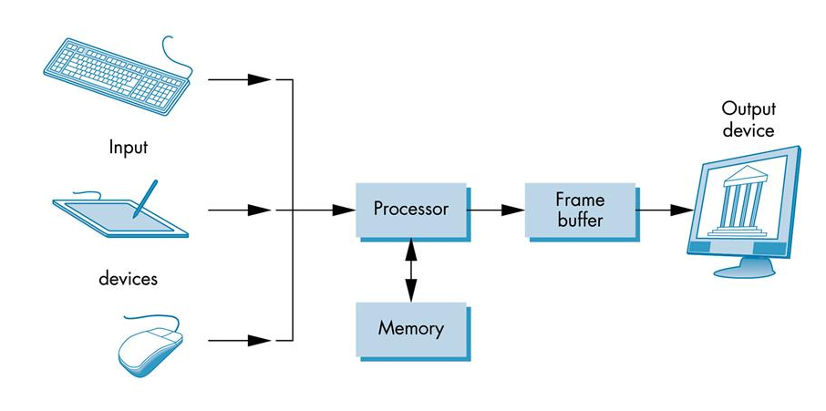
Graphics Systems and Models
A Graphics System
Processor
Memory
Frame Buffer
Display
Input Devices
Output Devices

Slide 38
Graphics Paradigms
Modeling
Rendering
Photo-realistic:
Ray tracing
Radiosity
Interactive:
Projection – camera model
Transformations, clipping
Shading
Texture mapping
Rasterization

Slide 39
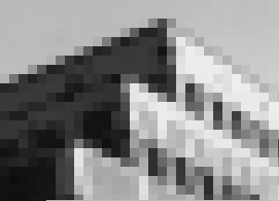
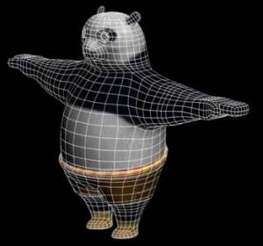
Graphics Paradigms
Sample-based
Geometry-based

Slide 40
Sample-based Graphics
Discrete samples are used to describe visual information
Pixels created by digitizing images, using a sample-based “painting” program, etc.
Often some aspect of the physical world is sampled for visualization, e.g., temperature across the US
Example programs:
Adobe Photoshop™, GIMP™ , Adobe AfterEffects™

Slide 41
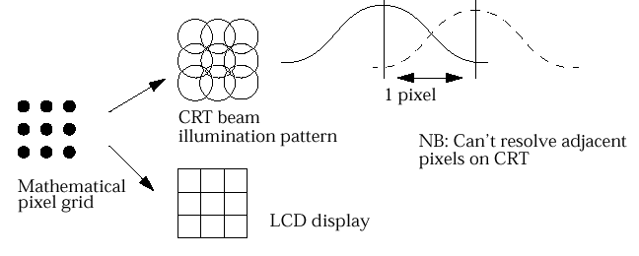
Sample-based Graphics
Pixels:
point locations with associated sample values
light intensities/colors, transparency, and other control information
Sample an image
sample the point location along the continuous signal
Pixels displayed as little circles or squares
CRT beam illumination pattern
light intensity
1 pixel
Visualization of a
mathematical pixel grid
Can’t visually resolve adjacent pixels on CRT
LCD display

Slide 42
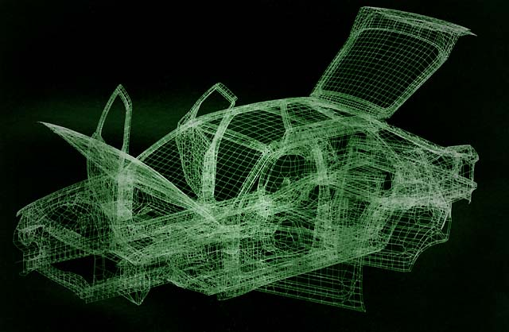
Geometry-Based Graphics
vector graphics
geometrical model is created, along with various appearance attributes, and is then sampled for visualization (rendering, a.k.a image synthesis)
aspects of physical world is visually simulated, or “synthesized”
2D apps:
Adobe Illustrator™, Adobe Freehand™, Corel CorelDRAW™
3D apps:
Autodesk’s AutoCAD™, Autodesk’s Maya™, Autodesk’s 3D Studio Max™

Slide 43
Geometry-Based Graphics
Store models
mathematical descriptions of elements and attributes
primitive shapes (point, line, polygon, ellipse…)
Images are created via sampling of geometry for viewing, but not stored as part of model.
Users manipulates geometric elements, program resamples and redisplays elements
cannot usually work directly with individual pixels

Slide 44
What is Geometric Modeling?
Model captures salient features (data, behavior) of thing/phenomenon being modeled
data includes geometry, appearance, attributes…
note similarity to OOP ideas
Modeling allows us to cope with complexity
CG focus:
modeling and viewing simple everyday objects

Slide 45
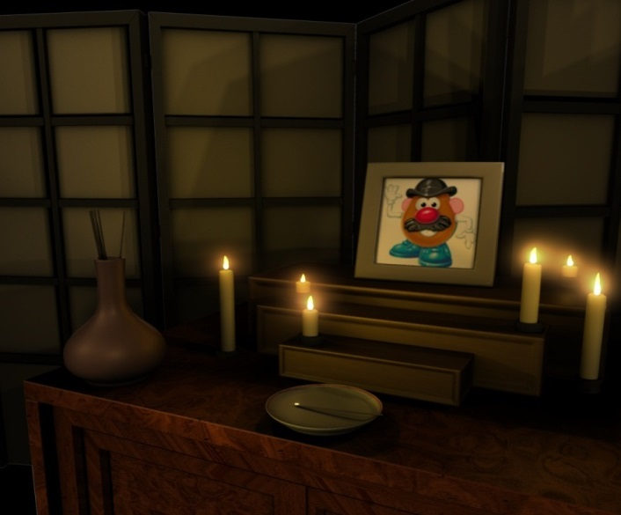
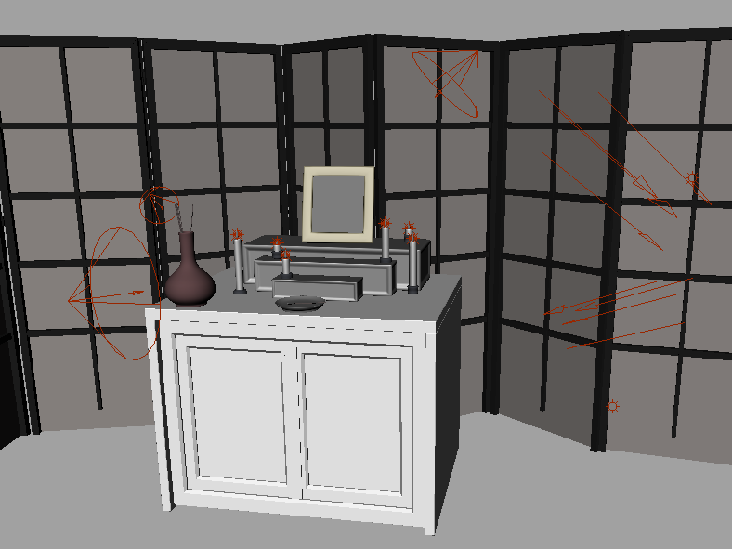
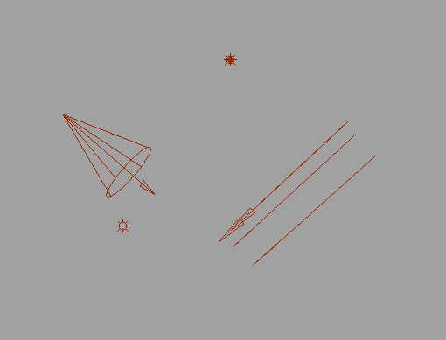
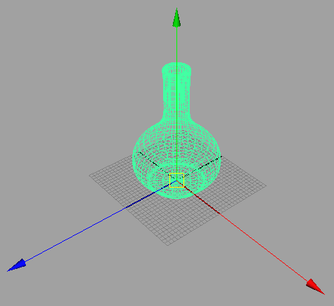
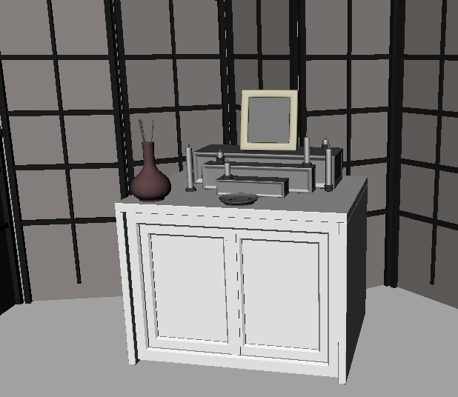
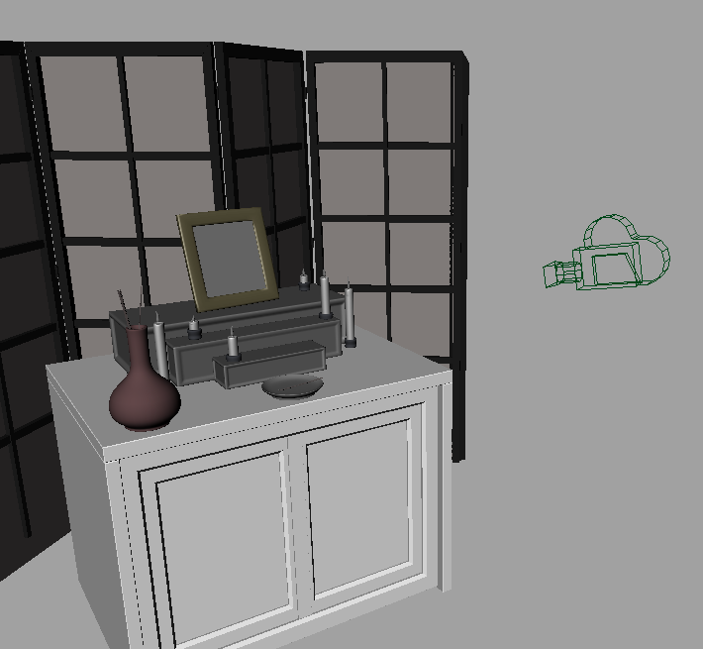
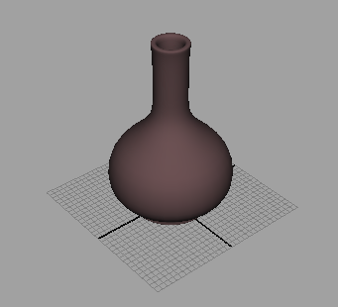
Modeling vs. Rendering
Modeling
Create models
Apply materials to models
Place models around scene
Place lights in scene
Place the camera
Rendering
Take “picture” with camera
Both can be done with commercial software:
Autodesk MayaTM ,3D Studio MaxTM, BlenderTM, etc.
Point Light
Spot Light
Directional Light
Ambient Light

Slide 46
Geometry-Based Graphics Rendering Approaches
Rendering is the final process of creating the actual 2D image or animation from the prepared scene.
Two methods of producing images of three-dimensional solid objects.
Ray tracing
Polygon based rendering

Slide 47
Ray TRacing

Slide 48

Ray-traced blob
Notes:
How would you write a program to generate this image?

Slide 49
How does Ray-Tracing work?
Modeling
Build a 3D model of the world
Geometric primitives
Light sources
Material properties
Simulate the bouncing of light rays
Trace ray from eye through image pixel to see what it hits
From there, bounce ray in reflection direction, towards light source, etc.
Thus, model physics of emission, reflection, transmission, etc. (backwards)

Slide 50

Ray thru pixel

Slide 51

Flat blob
Notes:
Why does this image look so poor? It's entirely flat. There's no real sense of shape, of depth. Why is that?
Our previous model wasn't very accurate – realistically, more light bounces off the object toward our eye when the object is pointed directly toward a light; less when the surface slants away from light sources.

Slide 52

Bounce toward lights
Notes:
How would you know what color to use for each pixel of the image? The basic idea is to "shoot a ray" from the eye, through the pixel of the image, and see what part of the world model it hits first. If it hits a red object, we color that pixel red.
What would you get using this approach, do you think?

Slide 53

Shadows

Slide 54

Shaded blob

Slide 55
Blob with Highlights

Slide 56

Blob with ground plane

Slide 57

Blob with transparency

Slide 58

Blob with refraction

Slide 59

What are these made of?

Slide 60

Textures

Slide 61

POV-Ray Primitives

Slide 62

Constructive Solid Geometry

Slide 63

Sunsethf

Slide 64

Ray Tracing Contest
http://www.irtc.org/stills/

Slide 65

Ray Tracing Contest
http://www.irtc.org/stills/

Slide 66
Drawbacks of ray tracing?
Time: many rays are needed per pixel…
Up to 25 rays through each pixel
Each ray may bounce and split many times
Each ray tested for intersection with many objects
E.g. 1M pixels * 25 rays per pixel * 40 rays per ray tree * 1000 objects = 1 trillion object intersection tests…
Too slow for real time?
Hard lighting
No soft shadows, inter-object diffusion, etc

Slide 67
Beyond Ray Tracing
Problems with ray tracing:
hard shadows
slow
Notes:
How else could you generate realistic-looking images – without the hard shadows and aliasing? Color bleed?

Slide 68
Polygon Based Rendering
polygons are rendered
normally one at a time
into a frame buffer.
Is fast
support simplistic lighting models
images do not necessarily look realistic.
Single primitive: the polygon
everything must be made up of flat surfaces.

Slide 69
Polygon Rendering

Slide 70

Shutterbug - Orthographic
Notes:
Mention source of images
Mention renderman, pixar

Slide 71

- Perspective
Notes:
Perspective projection

Slide 72

- Depth Cueing
Notes:
Depth Cueing -

Slide 73

- Depth Clipping
Notes:
Depth clipping

Slide 74

- Colored Edges
Notes:
Colored edges

Slide 75

- Hidden line removal
Notes:
Hidden lines removed

Slide 76

- Flat shading
Notes:
Individually shaded polygons with diffuse reflection

Slide 77

- Gouraud shading
Notes:
Gouraud-shaded polygons with diffuse reflection

Slide 78

- Gouraud/specular
Notes:
Gouraud shading with specular reflection

Slide 79

- Gouraud/phong
Notes:
Phong shading with specular reflection

Slide 80

- Curved surfaces
Notes:
Curved surfaces

Slide 81

- Improved illumination
Notes:
Improved illumination model with multiple lights

Slide 82

- Texture mapping
Notes:
Texture mapping

Slide 83

- Reflections
Notes:
Reflections

Slide 84




Rendering Pipeline
Rendering Pipeline

Slide 85


Rendering Pipeline
Scene Description:
Geometric Model
Polygon Mesh Vertex
Polygon Vertex
View (camera specification)
Lighting Data
Texture Data
Image:
Color values for pixels
frame buffer

Slide 86

Rendering Pipeline
Primitives are processed in a series of stages
Each stage forwards its result on to the next stage
can be drawn and implemented in different ways
Stages in hardware or software
Optimizations & additional programmability are available at some stages

Slide 87

Rendering Pipeline
3D models defined in their coordinate system (object space)
Modeling transforms orient the models within a common coordinate frame (world space)
Positioning in scene

Slide 88

Rendering Pipeline
Vertices lit (shaded) according to material properties, surface properties (normal) and light source
Local lighting model (Diffuse, Ambient, Phong, etc.)

Slide 89

Rendering Pipeline
Maps world space to eye space
Viewing positions is transformed to original & direction is oriented along some axis (usually z)

Slide 90

Rendering Pipeline
Portions of the object outside the view volume (view frustum) are removed

Slide 91

Rendering Pipeline
The objects are projected to the 2D image place (screen space)

Slide 92

Rendering Pipeline
Rasterizes objects into pixels
Interpolate values as we go (color, depth, etc.)

Slide 93

Rendering Pipeline

Slide 94





Graphics Library
OpenGL™, DirectX™, Windows Presentation Foundation™ (WPF), RenderMan™, HTML5 + WebGL™
Primitives: characters, lines, polygons, meshes,…
Attributes: Color, line style, material properties
Lights
Transformations
Draw mode
immediate mode: no stored representation, package holds only attribute state, and application must completely draw each frame
retained mode: library compiles and displays from scenegraph (complex DAG) that it maintains.

Slide 95
OpenGL
OpenGL: a widely-used, open API for 3D graphics
Old, originally from Silicon Graphics (SGI)
Low-level, procedural (vs. scene graph retained mode)
Designed for speed, control over hardware
Need hardware support for top performance
Widely used for CAD, VR, visualization, flight simulators
Managed by non-profit “Khronos Group” consortium
Support
All major graphics cards, platforms have support
Mobile devices (iOS, Android) use an embedded version
HTML5 has experimental WebGL support
Bindings for JavaScript, Java, C#, Perl, Python, Ruby, Scheme, Visual Basic, Ada, …

Slide 96
Graphics Only
OpenGL does not support windowing, interaction, UI, etc
It must be used with another windowing system/library such as
MS Windows—various
Cocoa
X11
Qt
GLUT, GLFW
HTML5 JavaScript?
Notes:
GLUT, GLFW: simple, fast, cross-platform windowing for OpenGL

Slide 97

History
GL (SGI), 1980s to early 1990s [reality engine?]
OpenGL Architecture Review Board, 1992
Selected versions:
1.0, 1992 (Happy Twentieth birthday!)
1.3, 2001—better texture support
2.0, 2004—GLSL (GL Shading Language, user programmable vertex shaders)
3.0, 2008—plan: fundamental changes to the API—no longer state-based, requires use of GLSL 1.3. Compromise: old API deprecated (but still used)
4.1, 2010—new geometry control, shaders, OpenGL ES 2.0 compatibility
4.3, 2012—compatibility with OpenGL ES 3.0

Slide 98

http://wiki.maemo.org/OpenGL-ES

Slide 99
OpenGL ES
OpenGL ES (for Embedded Systems) is a subset of OpenGL for mobile phones, consoles, etc
Common and Common Lite profiles (lite profiles are fixed-point only)
Version 2.0 released in 2007
GLSL for shaders
Supported in iOS, Android, Maemo, WebGL, Blackberry, WebOS…
Version 3.0, 2012: texture compression, new version of GLSL ES, 32-bit floats, enhanced texturing

Slide 100
WebGL
OpenGL 2.0 ES in your Web browser, no plugins needed!
Supported by all major browsers except IE (Microsoft hates Web standards, OpenGL)
Working group: Apple, Google, Mozilla, Opera (not Microsoft)

Slide 101
Other software used
HTML5 Canvas element for 2D graphics
The only cross-platform environment nowadays.
POV ray-tracer

Slide 102
Modelagem
Como...
Representar objetos 3D em um computador?
Construir tais representações de maneira rápida e automática com um computador ?
Manipular objetos 3D com um computador ?
Diferentes métodos para diferentes representações

Slide 103




Modelagem Como Representar estes Objetos?

Slide 104


Modelagem Como Representar estes Objetos?

Slide 105
2D Object Definition
Lines and polylines:
Polylines: lines drawn between ordered points
closed polyline -> polygon
simple polygon has no self-intersections
Convex and concave polygons:
Convex: Line between any two points is inside polygon
Concave: At least one line between two points crosses polygon border
not closed,
simple polyline
simple polygon,
closed polyline
not simple polygon,
closed polyline
convex
concave

Slide 106
2D Object Definition
Special Polygons:
Circles:
Set of all points equidistant
from one point (center)
Radius - distance from the center
Equation for a circle centered at (0, 0)
r² = x² + y²
Triangle
Square
Rectangle
(x, y)
(0, y)
r
(0, 0)
(0, x)

Slide 107
2D Object Definition
A circle can be approximated by a polygon with many sides.
Axis aligned ellipse: a circle scaled in the x and/or y direction
6
6
5
5
4
4
3
3
2
2
1
1
0
0
1
2
3
4
5
6
7
8
9
10
1
2
3
4
5
6
7
8
9
10
Scaled by a factor of 2 in the x direction and not scaled in the y direction. Width changes from 3.5 to 7.

Slide 108
Representações 3D Representações da Geometria
Representações 3D fornecem os fundamentos para Comp. Gráfica, CAD, Visualização, Robótica, ...
Representações são linguagens para descrever Semântica e Sintaxe da geometria
Semântica:
valores; operações
Sintaxe:
Estruturas de dados; algoritmos
Estruturas de dados determinam os algoritmos

Slide 109
Representações 3D
Dados Não Estruturados
Nuvens de pontos
Imagens com profundidade
Conjuntos de polígonos
Aramado
Superfícies
Malhas
subdivisão
Paramétricas
Implícitas
Sólidos
Voxels
BSP tree
CSG
Sweep
Estruturas de Alto-nível
Grafo de cena
Esqueletos
Específicos de aplicação

Slide 110
Representações 3D
Exatas
Exemplos
Aramado
Superfícies paramétricas
Modelos Sólidos
CSG
BRep
Superfícies implícitas
Modelo preciso da topologia do objeto
Representa toda a geometria matemáticamente
Aproximadas
Exemplos:
Faces / Malhas
Só superfície
Voxel
Informação de Volume
Discretização do objeto 3D
Usa primitivas simples para modelar a topologia e a geometria

Slide 111
Representações 3D Desvantagens
Exatas
Estruturas de dados complexas
Algoritmos caros
Grande variedade de formatos, cada um com diversas nuances
Difícil de capturar os dados
Requer tradução para o rendering
Aproximadas
Com perda de informação
Grande estrutura de dados para obter boa fidelidade
Fácil de aparecer erros
Não apropriada para certas aplicações
Várias trabalhos de interpolaçãos e estimativas

Slide 112
Representações 3D Vantagens
Exatas
Precisão
Simulation, modeling, ...
Muitos ambientes de modelagem
Propriedades físicas
Muitas aplicações
Compacta
Aproximadas
Fácil de implementar
Fácil de adquirir
3D scanner, CT
Fácil de renderizar
Mapeamento direto no pipeline de rendering
Muitos algoritmos

Slide 113



Representações 3D –Não Estruturados Nuvens de Pontos
Conjunto não estruturado de pontos 3D
Pontos representam amostragem de valores que descrevem o objeto
Oriundos de visão computacional ou scanners de profundidade
laser scannners
Câmeras de profundidade

Slide 114

Representações 3D –Não Estruturados Imagens com Profundidade
Conjunto de pontos 3D mapeados a pixels de uma imagem de profundidade
oriundos de um scanner de profundidade (range scanner)

Slide 115

Representações 3D –Não Estruturados Conjuntos de Polígonos
Conjuntos não estruturados de polígonos
Criado com sistemas de modelagem interativos?

Slide 116

Aramado
Conjunto de vértices e arestas
Simples
Não representa relações topológicas entre vértices e arestas

Slide 117

Aramado
Problemas:
Inconsistência
Ambiguidade visual
Sem superfícies
O que esta dentro? E fora?
Remoção de linhas ocultas?
Como modelar formas em aramados
Aresta por aresta? Não muito fácil!

Slide 118



Representações 3D – Malhas
Conjunto conectado de polígonos ( em geral, triângulos)
Pode ser uma malha não fechada

Slide 119

Representações 3D – Superfícies Superfícies por Subdivisão
Malha pouco refinada e uma regra de subdivisão
Define uma superfície suave como uma sequência de refinamentos

Slide 120


Representações 3D – Superfícies Superfícies Paramétricas
Geradas pelo produto tensorial de retalhos de splines
Restrições cuidadosamente colocadas para manter a continuidade

Slide 121

Representações 3D – Superfícies Superfícies Implícitas
Pontos satisfazendo: F(x,y,z) = 0

Slide 122



Representações 3D – Sólidos Voxels
Amostragem uniforme de um campo escalar em uma grade tridimensional
Adquiridos de CT, RM, Sísmica de reflexão, Volume Graphics

Slide 123

Representações 3D – Sólidos Árvore BSP
Árvore binária de partição do espaço
Construída a partir de representações poligonais

Slide 124

Representações 3D – Sólidos CSG
Hierarquia de operações booleanas sobre conjuntos (união,diferença, interseção) aplicadas a formas simples

Slide 125


Representações 3D – Sólidos CSG

Slide 126

Sweep
Movimento suave de uma curva ao longo de uma trajetória

Slide 127

Grafo de Cena
União de objetos que se encontram nas folhas

Slide 128


Esqueletos
Gráfico de curvas com um raio associado

Slide 129

Taxonomia das Representações

Slide 130
Diferenças Computacionais
Eficiência
Combinatorial complexity (e.g. O( n log n ) )
Space/time trade-offs (e.g. z-buffer)
Precisão e estabilidade numérica (grau do polinômio)
Simplicidade
Facilidade de aquisição
Aceleração por hardware
Software para criação e manutenção
Usabilidade
Interface de projeto versus motor computacional

Slide 131




Building 3D Primitives
Made out of 2D and 1D primitives
Triangles are commonly used
Many triangles used for a single object is a triangular mesh
Splines used to describe boundaries of "patches" – these can be "sewn together" to represent curved surfaces

Slide 132



Three Dimensional Primitives
Full range of graphics primitives cannot be supported by graphics systems – some are approximated
most graphics systems optimized for procession points and polygons, polygons in E3 are not planar – tessellation is required or made by the system itself
Constructive Solid Geometry (CSG) – objects build using set operations like union, intersection, difference etc.

Slide 133


Polygonal Meshes
Cg preferred way of 3d models
Collection of polygons, or faces, that form “skin” of object
More flexible, represents complex surfaces better
Examples:
Human face
Animal structures
Furniture, etc

Slide 134

Polygonal Mesh Example

Slide 135


Slide 136


Slide 137


Slide 138
Simple Representation
Define each polygon by (x,y,z) location of its vertices

Slide 139


Slide 140


Slide 141

Notes:
Use the right-hand rule = conter-clockwise encirclement of outward-pointing normal
Focus on direction of traversal
Orders {v1, v0, v3} and {v3, v2, v1} are same (CCW)
Order {v1, v2, v3} is diferente (clockwise)
What is outward-pointing normal?

Slide 142


Slide 143


Slide 144


Slide 145


Slide 146


Slide 147


Slide 148

List Of Faces

Slide 149

Triangle Meshes
Most common representation of shape in 3D
All vertices of triangle are guaranteed to lie in one plane (not true for other polygons)
Uniformity makes it easy to perform mesh operations such as subdivision, simplification, transformation etc.
Many different ways to represent triangular meshes

Slide 150

Triangular Mesh Representation
Vertex and face tables, analogous to 2D vertex and edge tables
Each vertex listed once, triangles listed as ordered triplets of indices into the vertex table
Edges inferred from triangles
It’s often useful to store associated faces with vertices (i.e. computing normals: vertex normal average of surrounding face normals)
Vertices listed in counter clockwise order in face table.
No longer just because of convention. CCW order differentiates front and back of face

Slide 151
Kinds of Graphics Software
Photoshop, Illustrator, etc.
3D Modeling (CAD, animation)
Rendering (ray tracing, radiosity)
Animation tools
Graphics programming APIs (OpenGL, DirectX)
Scene graph libraries
Game engines
Notes:
3D modeling programs: 3D Studio Max, Lightwave, Maya, Blender
Rendering: POV Ray, RenderMan, many others
Animation: Maya, Lightwave, Blender, many others

